Slide 1
US Military Ranks and Insignia

Slide 2
Enlisted Ranks
Rank | Army | Marines | Navy | Air Force | Space Force | Coast Guard
E-1 | Private | Private | Seaman Recruit (SR) | Airman Basic | Specialist 1 (Spc1) | Seaman Recruit (SR)
E-2 | Private (PV2) | Private First Class (PFC) | Seaman Apprentice (SA) | Airman | Specialist 2 (Spc2) | Seaman Apprentice (SA)
E-3 | Private First Class (PFC) | Lance Corporal (LCpl) | Seaman (SN) | Airman First Class (A1C) | Specialist 3 (Spc3) | Seaman (SN)
E-4 | Corporal (CPL) ------------------ Specialist (SPC) | Corporal (Cpl) | Petty Officer Third Class (PO3) | Senior Airman (SrA) | Specialist 4 (Spc4) | Petty Officer Third Class (PO3)
E-5 | Sergeant (SGT) | Sergeant (Sgt) | Petty Officer Second Class (PO2) | Staff Sergeant (SSgt) | Sergeant (Sgt) | Petty Officer Second Class (PO2
E-6 | Staff Sergeant (SSG) | Staff Sergeant (SSgt) | Petty Officer First Class (PO1) | Technical Sergeant (TSgt) | Technical Sergeant (TSgt) | Petty Officer First Class (PO1)
E-7 | Sergeant First Class (SFC) | Gunnery Sergeant (GySgt) | Chief Petty Officer (CPO) | Master Sergeant (MSgt) ------------------- First Sergeant | Master Sergeant (MSgt) | Chief Petty Officer (CPO)
E-8 | Master Sergeant (MSG) ------------------- First Sergeant (1SG) | Master Sergeant (MSgt) ------------------- First Sergeant | Senior Chief Petty Officer (SCPO) | Senior Master Sergeant (SMSgt) ------------------ First Sergeant | Senior Master Sergeant (SMSgt) | Senior Chief Petty Officer (SCPO)
E-9 | Sergeant Major (SGM) ------------------- Command Sergeant Major (CSM) | Master Gunnery Sergeant (MGySgt) -------------------- Sergeant Major (SgtMaj) | Master Chief Petty Officer (MCPO) ------------------- Fleet/Command Master Chief Petty Officer | Chief Master Sergeant (SMSgt) -------------------- Fist Sergeant ------------------- Command Chief Master Sergeant | Chief Master Sergeant (SMSgt) | Master Chief Petty Officer (MCPO) ------------------- Fleet/Command Master Chief Petty Officer
Senior Enlisted Advisors | Sergeant Major of the Army (SMA) | Sergeant Major of the Marine Corps (SgtMajMC) | Master Chief Petty Officer of the Navy (MCPON) | Chief Master Sergeant of the Air Force (CMSAF) | Chief Master Sergeant of the Space Force (CMSSF) | Master Chief Petty Officer of the Coast Guard (MCPOCG)
Source: “U.S. Military Rank Insignia,” U.S. Department of Defense, accessed August 26, 2022, https://www.defense.gov/Resources/Insignia/.

Slide 3
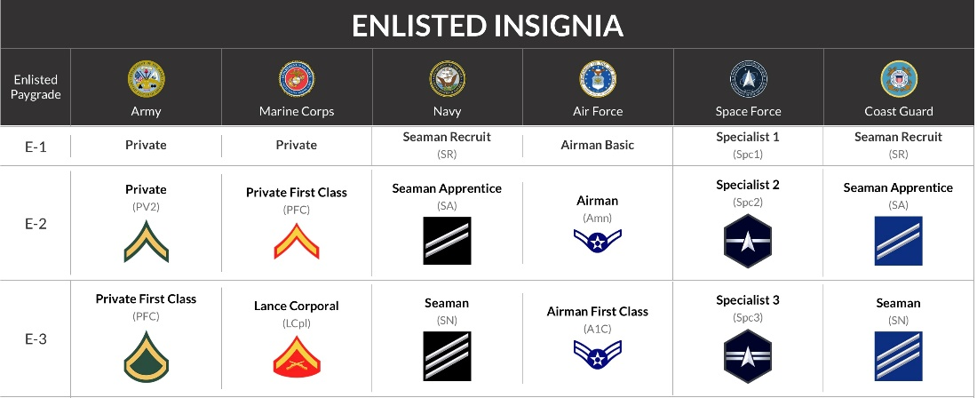
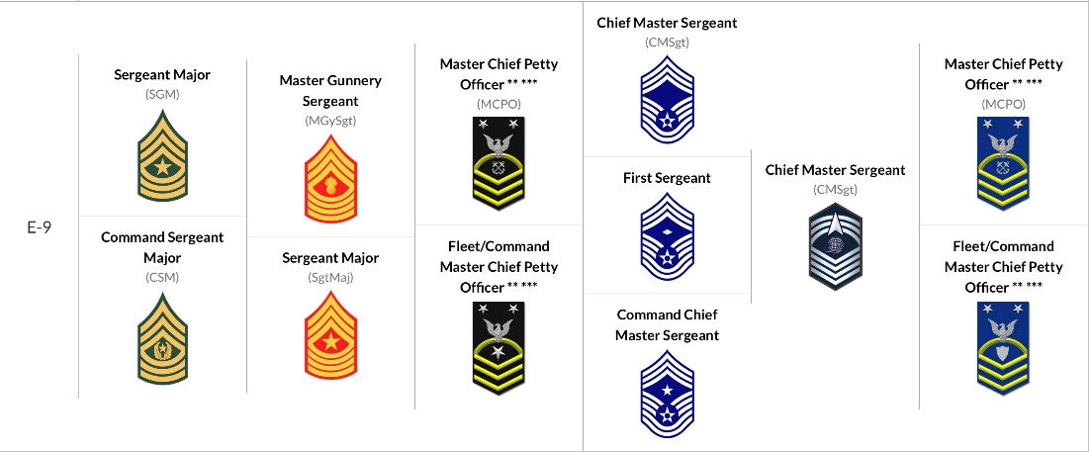
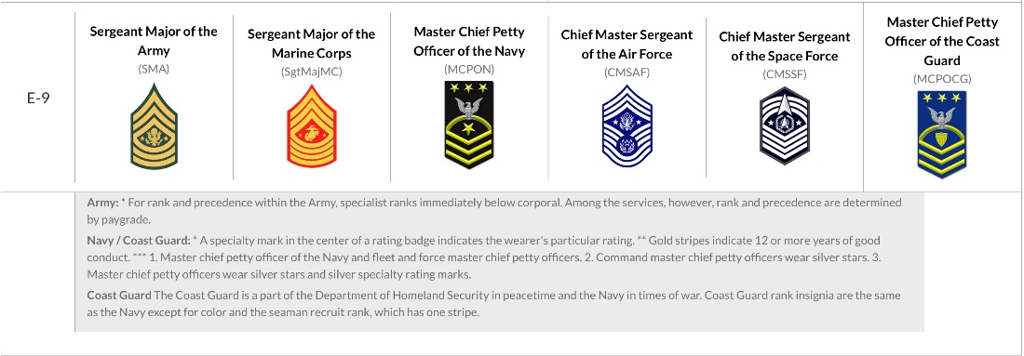

Slide 4
Officer Ranks
Rank | Army | Marines | Navy | Air Force | Space Force | Coast Guard
W-1 | Warrant Officer 1 (WO1) | Warrant Officer 1 (WO) | USN Warrant Officer 1 (WO1) | N/A | N/A | N/A
W-2 | Chief Warrant Officer 2 (CW2) | Chief Warrant Officer 2 (CWO2) | USN Chief Warrant Officer 2 (CWO2) | N/A | N/A | Chief Warrant Officer 2 (CWO2)
W-3 | Chief Warrant Officer 3 (CW3) | Chief Warrant Officer 3 (CWO3) | USN Chief Warrant Officer 3 (CWO3) | N/A | N/A | Chief Warrant Officer 3 (CWO3)
W-4 | Chief Warrant Officer 4 (CW4) | Chief Warrant Officer 4 (CWO4) | USN Chief Warrant Officer 4 (CWO4) | N/A | N/A | Chief Warrant Officer 4 (CWO4)
W-5 | Chief Warrant Officer 5 (CW5) | Chief Warrant Officer 5 (CWO5) | USN Chief Warrant Officer 5 (CWO5) | N/A | N/A | N/A
O-1 | Second Lieutenant (2LT) | Second Lieutenant (2ndLt) | Ensign (ENS) | Second Lieutenant (2nd Lt) | Second Lieutenant (2nd Lt) | Ensign (ENS)
O-2 | First Lieutenant (1LT) | First Lieutenant (1stLt) | Lieutenant Junior Grade (LTJG) | First Lieutenant (1st Lt) | First Lieutenant (1st Lt) | Lieutenant Junior Grade (LTJG)
O-3 | Captain (CPT) | Captain (Capt) | Lieutenant (LT) | Captain (Capt) | Captain (Capt) | Lieutenant (LT)
O-4 | Major (MAJ) | Major (Maj) | Lieutenant Commander (LCDR) | Major (Maj) | Major (Maj) | Lieutenant Commander (LCDR)
O-5 | Lieutenant Colonel (LTC) | Lieutenant Colonel (LtCol) | Commander (CDR) | Lieutenant Colonel (Lt Col) | Lieutenant Colonel (Lt Col) | Commander (CDR)
O-6 | Colonel (COL) | Colonel (Col) | Captain (CAPT) | Colonel (Col) | Colonel (Col) | Captain (CAPT)
O-7 | Brigadier General (BG) | Brigadier General (BGen) | Rear Admiral Lower Half (RDML) | Brigadier General (Brig Gen) | Brigadier General (Brig Gen) | Rear Admiral Lower Half (RDML)
O-8 | Major General (MG) | Major General (MajGen) | Rear Admiral Upper Half (RADM) | Major General (Maj Gen) | Major General (Maj Gen) | Rear Admiral Upper Half (RADM)
O-9 | Lieutenant General (LTG) | Lieutenant General (LtGen) | Vice Admiral (VADM) | Lieutenant General (Lt Gen) | Lieutenant General (Lt Gen) | Vice Admiral (VADM)
O-10 | General (GEN) | General (Gen) | Admiral (ADM) | General (Gen) | General (Gen) | Admiral (ADM)
Wartime Only | General of the Army | N/A | Fleet Admiral | General of the Air Force | N/A | Fleet Admiral
Source: “U.S. Military Rank Insignia,” U.S. Department of Defense, accessed August 26, 2022, https://www.defense.gov/Resources/Insignia/.

Slide 5
