Slide 1

Veteran sUpport @ Vontier
Matthew J. Louis
Louis Advisors LLC
July 2024
COPYRIGHT
Notes:
Thank you all so much. Thank you for the invitation to spend a little time with you this evening and discuss the challenges you face on this journey to the real world.
We will also spend a little time discussing ways to overcome those challenges, but I’m going to leave the bulk of that material for your own consumption and execution.

Slide 2
Agenda
Introduction
Why Veterans Need Support & How to Align Stakeholders
Support & Resources
COPYRIGHT
Notes:
So here is our agenda…

Slide 3

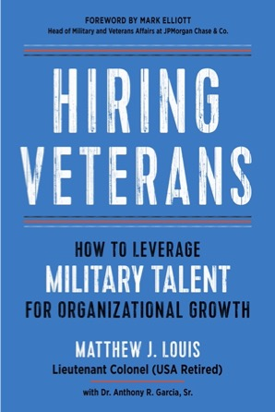
Introduction
Origin Story &
Geographic Scope Caveat

Slide 4
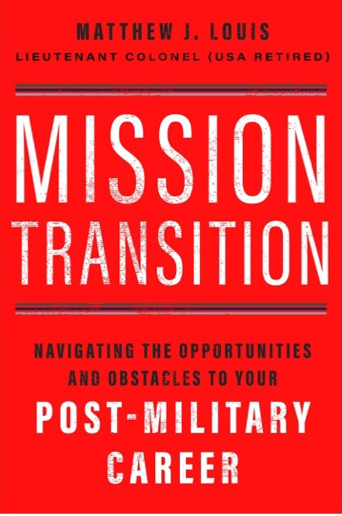
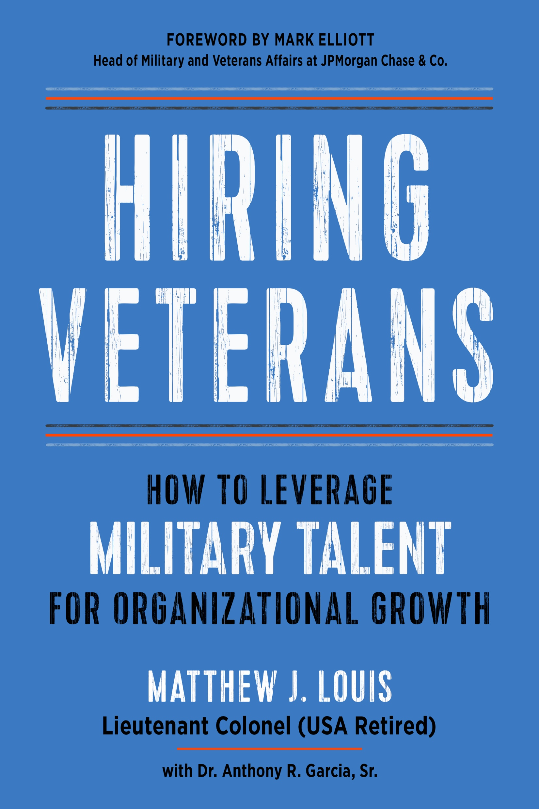










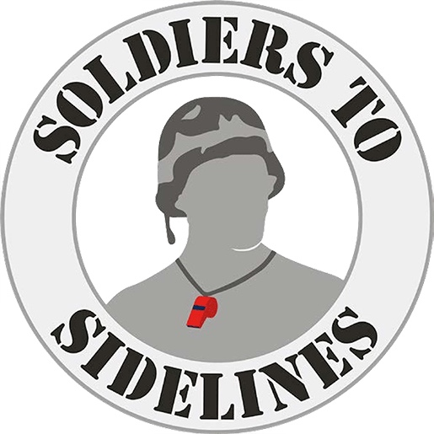
















Matt Louis – Career on One Page
Mission: Eliminating the civil-military divide in the US
25 Years in uniform
25 Years+ in the corporate world
Clients
Career History
Employers
Louis Advisors LLC
Education
Previous Employers
1991
1996
1998
2004
2005
2006
2009
2012
2015
2018
2021
2022
2023
Not To Scale

Slide 5
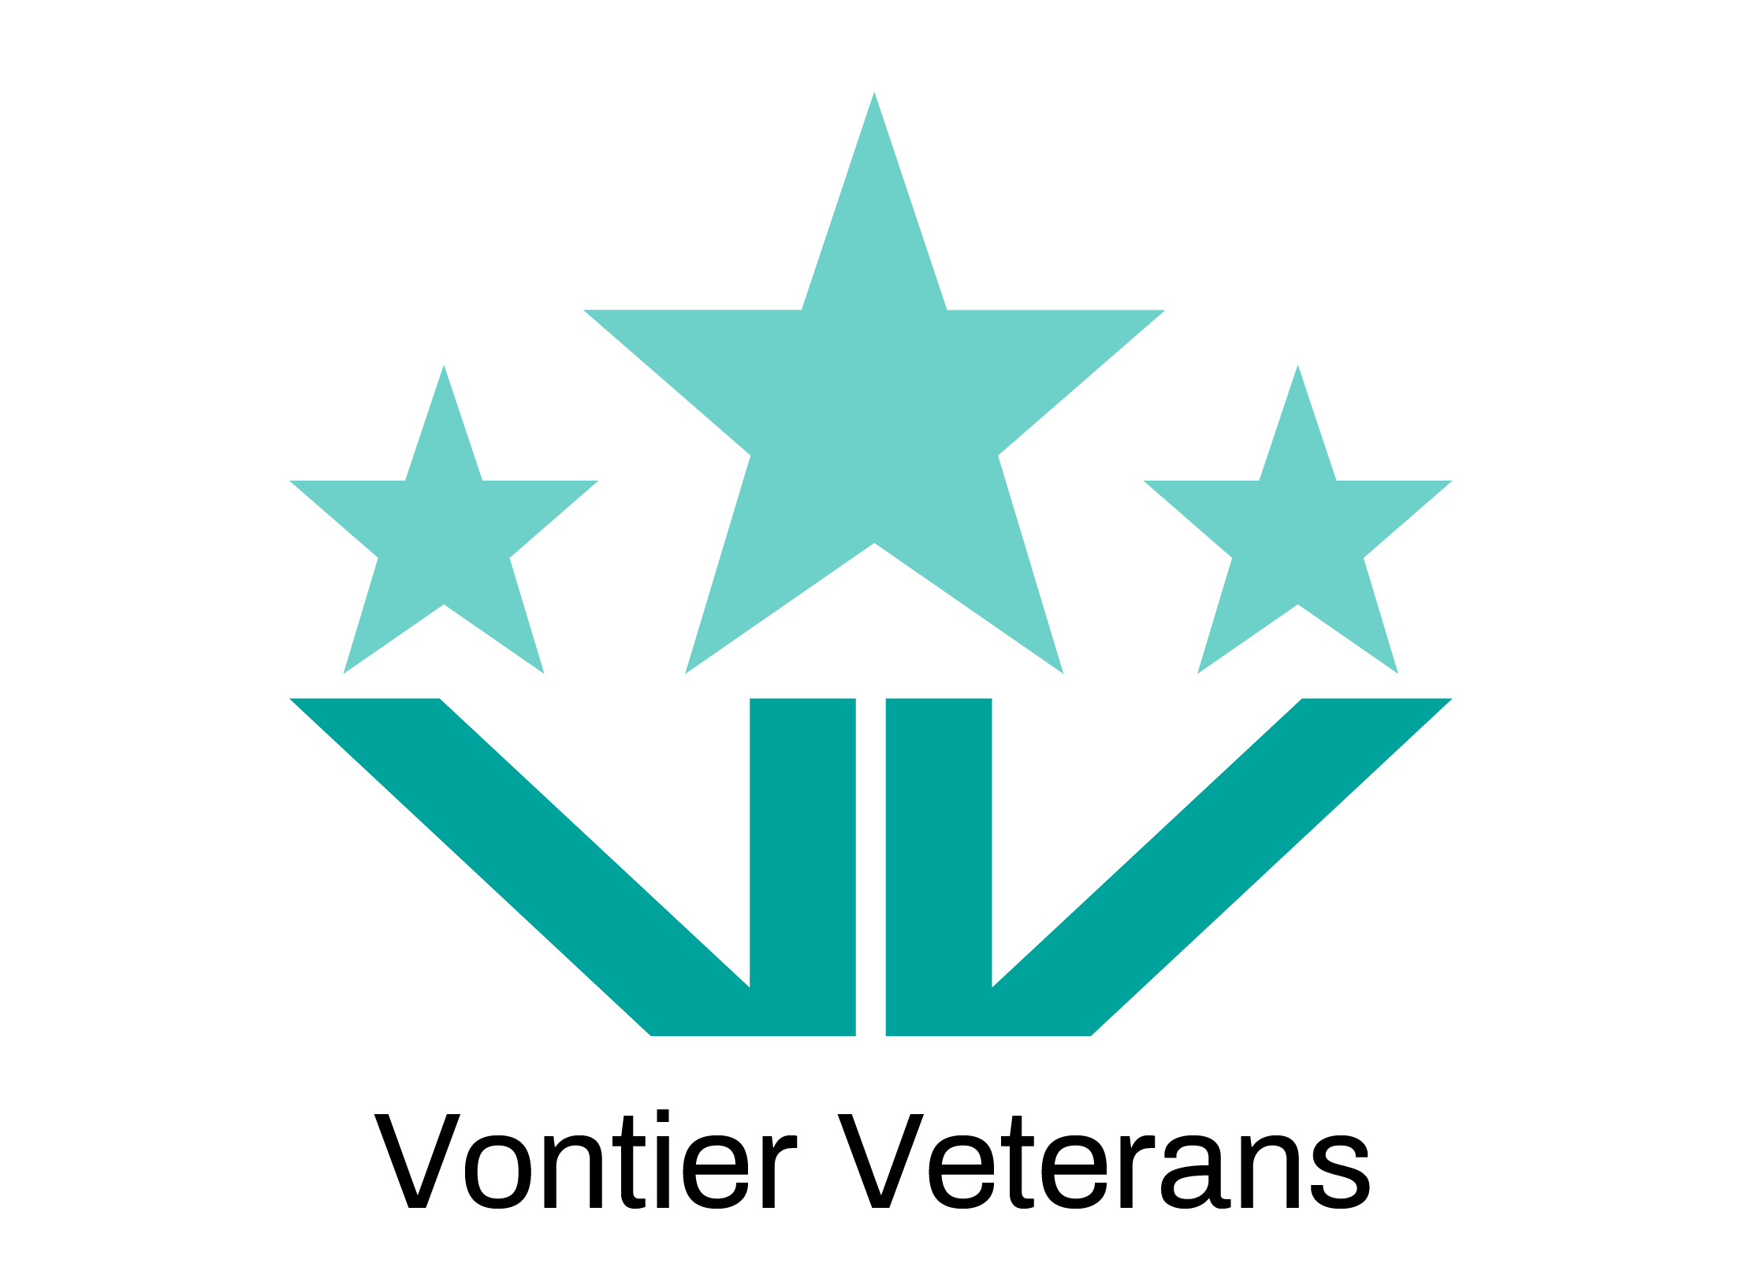
Veterans @ Vontier
Kudos to Vontier
  Military ERG – Vontier Veterans
  Mission: the recruitment, networking and community support of Veterans by working alongside all of our allies.
  Values / Culture that support / align with military
    Pioneering, Agile, Collaborative, Inclusive, Accountable, Customer Driven, Self Aware
Recognition
  Military-Friendly Employer
  Military Spouse Friendly Employer
  Veteran Jobs Mission member since 2020
  Employer Support of the Guard and Reserve member
Secrets to success
  Executive sponsorship and support
  Strategic Veteran Program Partnerships
    Soldiers Angels, Wounded Warrior, Veteran Recognition, Heroes Center-High Point, and Community Service
    Employment partnerships: VetJobs, CASY, SMLA
  Collaboration with Vontier Allies Group for Veterans and other ERG Groups through intersectionality.

Slide 6
Veterans
Why Support is Needed
& How to Align Stakeholders

Slide 7
A National Security Crisis
FY2023 Active-duty Military Recruiting Shortfalls
Service | FY 2023 Recruiting Goal | FY 2023 Recruiting Shortfall
Army | 65,000 | 10,000 (15%)
Navy | 38,000 | 7464 (20%)
Air Force | 27,000 | 2700 (10%)
Military recruiting shortfalls
  All services (-Marines) missed their FY23 Recruiting Goal
  Army: 25% (15,000) recruiting shortfall in FY22 -> cut its active-duty end strength from 476,000 to 452,000 (5%), the smallest since before World War II
  Only 9 percent of young Americans said they would consider military service
  Only 23 percent of 17-24 year-olds qualify to serve
The suicide rate among post-9/11 veterans more than doubled between 2006-2016, with no end in sight
There is a direct correlation between suicidality and un-/under-employment in post-9/11 veterans
  53% of separating post-9/11 veterans will face a period of unemployment averaging 22 weeks
  ~63% of vets’ first jobs are NOT in their chosen career field, and the average time spent in those roles is only 1.56 years
  ~50% are still not in a job in their preferred career field by their SIXTH post-military job
Sources: LTC Frank Dolberry, USA & Charles McEnany, “’BE ALL YOU CAN BE’ – THE U.S. ARMY'S RECRUITING TRANSFORMATION,” AUSA, January 2024, accessed May 17, 2024, https://www.ausa.org/publications/be-all-you-can-be-us-armys-recruiting-transformation. Meghann Myers, “Army, Navy and Air Force predict recruiting shortfalls this year,” Military Times, April 19, 2023, accessed June 28, 2023, https://www.militarytimes.com/news/your-military/2023/04/19/army-navy-and-air-force-predict-recruiting-shortfalls-this-year/. Lt. Gen. David W. Barno, U.S. Army (ret.) and Dr. Nora Bensahel, “Addressing the U.S. Military Recruiting Crisis,” War On The Rocks, March 10, 2023, accessed June 26, 2023, https://warontherocks.com/2023/03/addressing-the-u-s-military-recruiting-crisis/. U.S. Department of Veterans Affairs, Office of Mental Health and Suicide Prevention. 2022 National Veteran Suicide Prevention Annual Report. 2022. Figure 5, Page 12. Accessed June 26, 2023, https://www.mentalhealth.va.gov/docs/data-sheets/2022/2022-National-Veteran-Suicide-Prevention-Annual-Report-FINAL-508.pdf. U.S Department of Veterans Affairs, “2015 Veterans Economic Opportunity Report,” accessed October 30, 2017, http://www.benefits.va.gov/benefits/docs/veteraneconomicopportunityreport2015.pdf. Maury, R., Stone, B., Bradbard, D.A., Armstrong, N.A., Haynie, J.M., “Workforce Readiness Alignment: The Relationship Between Job Preferences, Retention, and Earnings (Workforce Readiness Briefs, Paper No. 3),” Institute for Veterans and Military Families, Syracuse University, August 2016, accessed October 27, 2017, https://ivmf.syracuse.edu/wp-content/uploads/2016/08/USAA_paper3_8.30.16_REVISED_digtial.pdf. 2019 National Veteran Suicide Prevention Annual Report. See Matthew J. Louis, “Ending Post-9/11 Veteran Suicide: A summary of the causes of - and potential solutions to - a nation-wide scourge,” March 2020, https://matthewjlouis.com/media/post-9-11-veteran-suicide-white-paper/ .
Notes:
Let’s start with the fact that we have some ongoing problems that have metastasized into what some are calling a national security crisis.
Start with the fact that…
Add to that the fact that suicide rates in the post-9/11 cohort show no signs of abating…
Now, what does this have to do with Hiring Veterans, you might ask
Remember my reference to being a Really Useful Engine? Young Americans want to be really useful engines. And so do veterans.
So, let’s peel back the onion a bit and understand why this problem exists.

Slide 8

Business Value of Veterans
VA: “a person who served in the active military, naval, or air service, and who was discharged or released therefrom under conditions other than dishonorable.”
Entrepreneurial
Assume high levels of trust
Adept at skill transfer across contexts/tasks
Have advanced technical training
Comfortable/adept in discontinuous environments
High levels of resilience
Advanced team-building skills
Strong organizational commitment
Have had cross-cultural experiences
Experience/skill in diverse work settings
Promoted faster
Perform better
Easier to manage
…than their non-veteran peers
Source: Institute for Veterans and Military Families, “The Business Case for Hiring a Veteran: Beyond the Clichés,” Institute for Veterans and Military Families, March 5 2012, accessed October 30, 2017, https://ivmf.syracuse.edu/article/the-business-case-for-hiring-a-veteran-beyond-the-cliches/.
COPYRIGHT
Notes:
But why should organizations hire veterans? What is it about their experience, training, and education that would make you a good hire? Well, let’s think about it…
When you were in the military…
Did you ever have to create order from chaos with little oversight or direction? That makes you entrepreneurial.
Did you have to trust your peers? That makes you trustworthy.
Did you have to learn new skills or technology? That makes you adept at skills transfer.
Was it OK to just give up? That makes you resilient.
Did you work in a team? So you have team building skills, and I’ll bet you were loyal to that team as well.
Were you ever deployed? So you have cross-cultural experience in diverse work settings.
See – you have lots of skills, skills that make for a solid business case for hiring people just like you.
And by the way, that same business case applies to military spouses. Mil spouses also demonstrate resilience, adaptability, resourcefulness, team orientation, entrepreneurship, and civic engagement.
In fact, studies show that…
And while that’s true, I want to be careful here. Part of your strength as a veteran is that you’re coming from an organization where everyone in the organization was family.
No one person is greater than the whole. The team is the thing. You bring with you a sense of what brotherhood and sisterhood looks like.
To successfully assimilate with the balance of whatever organization you end up joining, I’d urge you to continue with that approach.

Slide 9
Question
Are veterans more or less educated than their civilian peers?
MORE
LESS
COPYRIGHT
Notes:
So if veterans are so valuable, what’s preventing organizations from hiring them?
We will talk more about the civil-military divide in a moment, but there are a number of stereotypes that tend to get in the way.
Let’s look at some of those and separate fact from fiction.
First…Are veterans more or less educated than their civilian peers?

Slide 10
Question
Are veterans more or less educated than their civilian peers?
Statistic | Veterans | Non-Veterans
% with High School Degree | 96.4% | 90.6%
Source: U. S. Department of Labor, Bureau of Labor Statistics, Current Population Survey, Table 3: Employment status of persons 25 years and over by veteran status, period of service, and educational attainment, 2021 annual averages. https://www.bls.gov/news.release/vet.t03.htm. Accessed August 26, 2022.
COPYRIGHT
Notes:
% with High School Degree
Veterans = 96.4%
Non-Veterans = 90.6%

Slide 11
Question
By what percentage are veterans more likely than non-veterans to have a graduate or other advanced degree?
<50%
50 – 100%
>100%
COPYRIGHT
Notes:
By what percentage are veterans more likely than non-veterans to have a graduate or other advanced degree?

Slide 12
Question
By what percentage are veterans more likely than non-veterans to have a graduate or other advanced degree?
160%
…and..
veterans with bachelor’s degrees have 3X more work experience than non-veterans
Sources: Melissa Boatwright and Sarah Roberts, “Veteran Opportunity Report: Understanding an untapped talent pool,” LinkedIn, accessed September 1, 2022, https://socialimpact.linkedin.com/content/dam/me/linkedinforgood/en-us/resources/veterans/LinkedIn-Veteran-Opportunity-Report.pdf.
COPYRIGHT
Notes:
160%

Slide 13
Veterans Bring Significant Education and Experience
Rank | Education | Military Role | Military Training | Transferable Skill Sets | Military Personnel Supervised | Equivalent Civilian Role | Civilian Personnel Supervised
O-7 – O-10 | Advanced Degree | Enterprise leader Coalition Leader (Joint Services, Interagency, International) | Advancer Senior Leader Education Joint Chiefs of Staff Education | Strategic Planning National Policy implementation Enterprise Policy development Advising Elected Officials | 10,000+ | CXO (CEO, COO, CFO, CIO, etc.) | 1000+
O4 – O-6 / W4 – W5 | Advanced Degree | Large Unit Leader Staff Commander | War College Command & General Staff College | Advanced leadership Organizational Controls Policy Development Long-term planning | 3000+ (O-6) 1000+ (O-5) | President, Vice President | 600+
O-1 – O-3 / W-1 – W-3 | Undergraduate Degree | Small unit leader | Officer Basic & Advanced Training Technical Schools | Tactical planning Team building Basic leadership Mentoring Operational experience Organizational administration | 150 (O-3) 40 (O-1/2) | Director, Operations Manager, Business Analyst, Engineer | ~250 30 16 8
E7 – E9 | Undergraduate Degree | Large-Size Unit Leader Senior Staff Leader / Member | Advanced professional and advisor courses | Strategic Management Advanced advisory Organizational administration | 200+ (E-9) 40-200 (E-7/8) | Supervisor | 8-40
E5 – E6 | Undergraduate Degree or High School / GED | Small unit leader | Basic leadership & technical schools | Basic leadership Team building Coaching | 10-60 | Team Leader | 3-12
E1 – E4 | High School / GED | Member of team | Basic training & technical schools | Teamwork Performance under pressure Accountability Honesty, loyalty | 0 | Analyst Programmer Generalist Specialist | 2 1 1 0
Source: Matthew J. Louis, Hiring Veterans: How to Leverage Military Talent for Organizational Growth (Newburyport, MA: Career Press, 2023).
COPYRIGHT
Notes:
Fact of the matter is Veterans Bring Significant Education and Experience…
See the red rectangle. These tend to be the typical ranks that organizations recruit from the military. I suspect most of you fall within that rectangle.
If you compare your military training, education, and supervisory responsibilities to that of your civilian peers, you’ll see the differences are quite stark.
Now that’s not to say that an Army captain can step immediately into a Director role in a business. Absolutely not.
That would be like saying that business Director could step immediately into the role of an Army company commander. That just doesn’t work.
There needs to be some transition, some training, some assimilation before an individual could assume such roles. We will talk about that later.

Slide 14
Question
What percentage of veterans served in a combat specialty?
0 – 25%
25 – 50%
50 – 75%
COPYRIGHT
Notes:
What percentage of veterans served in a combat specialty?

Slide 15
Question
What percentage of veterans served in a combat specialty?
<15%
COPYRIGHT
Notes:
<15%

Slide 16
Veterans Bring Significant Transferable Skills
Occupational Specialties | Army | Air Force | Coast Guard | Marines | Navy | Personnel per Occupational Specialty
Administrative | 6,140 | 14,046 | 1,507 | 12,018 | 18,635 | 52,346 | 4.8%
Combat Specialty | 109,625 | 677 | 649 | 39,850 | 8,388 | 158,689 | 14.5%
Construction | 15,313 | 5,195 | - | 6,252 | 3,987 | 30,747 | 2.9%
Electronics | 31,051 | 29,310 | 4,341 | 16,822 | 48,236 | 129,760 | 11.7%
Engineering | 43,567 | 49,162 | 1,256 | 26,917 | 39,611 | 160,513 | 14.5%
Healthcare | 29,986 | 15,441 | 707 | - | 25,345 | 71,479 | 6.4%
Human Resources | 16,558 | 7,720 | 1 | 2,214 | 3,941 | 30,434 | 2.8%
Machine Operator | 4,107 | 6,063 | 1,688 | 2,539 | 8,542 | 22,939 | 2.1%
Media and PR | 6,646 | 7,095 | 136 | 2,439 | 3,859 | 20,175 | 1.9%
Protective Service | 21,802 | 32,573 | 2,720 | 6,096 | 12,011 | 75,202 | 6.8%
Support Service | 9,901 | 4,981 | 1,145 | 2,263 | 8,129 | 26,419 | 2.5%
Transportation / Logistics | 48,096 | 27,840 | 9,879 | 23,213 | 37,709 | 146,737 | 13.4%
Vehicle / Machine Mechanic | 45,344 | 41,555 | 5,532 | 21,511 | 47,353 | 161,295 | 14.6%
Unspecified Code | 2,984 | 5,038 | 1,439 | 1,161 | 2,555 | 13,177 | 1.1%
Total | 391,120 | 246,696 | 31,000 | 162,795 | 268,301 | 1,099,912 | 100.0%
Bonus fact:
The largest group of individuals in the country with security clearances is in the military
Source: Bureau of Labor Statistics, U.S. Department of Labor, Occupational Outlook Handbook, Military Careers, https://www.bls.gov/ooh/military/military-careers.htm. Accessed September 20, 2022.
COPYRIGHT
Notes:
Check out this table. I’ve circled the percentage of service members that serve in a combat specialty. Now, let’s flip that figure on it’s head…
85% of military occupational specialties are in career fields that have directly transferable skills – think of engineers, construction, technology, healthcare, human resources, logistics, etc.
I was unfortunately one of those trigger pullers that represent the 15%. I was a tanker. The good news is that we don’t have Abrams tanks rolling down our streets. The bad news is that meant I needed to recreate myself.
Some of you may fall into that group as well. If you do, just know that you will need a little more time to self-reflect, uncover your transferable skills, and reinvent yourself.

Slide 17
Question
What portion of an employee population has a greater percentage of PTSD?
Veterans
Non-Veterans
COPYRIGHT
Notes:
What portion of any company’s employee population has a greater percentage of PTSD?

Slide 18
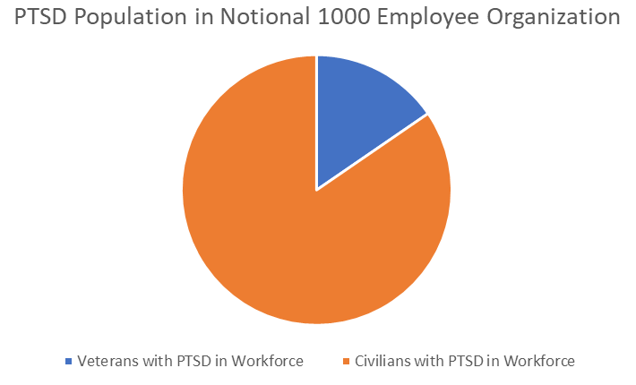
Veteran Myths
MYTH: Veterans are disproportionately affected by Post-Traumatic Stress
FACT: There are more than five times the number of civilians in your organization that have PTSD
Notional 1000—person organization
Veterans | Non-veterans
6% of veterans in labor pool 1000 x (6%) = 60 veteran employees | 1000 – 60 veteran employees = 940 non-veteran employees
11-20% of post-9/11 veterans have PTSD 20% x (60) = 12 veteran employees with PTSD | 7-8% of the adult US population will have PTSD 7% x (940) ~ 66 civilian employees with PTSD
Sources: “PTSD Basics,” U.S. Department of Veterans Affairs, PTSD: National Center for PTSD, Accessed September 1, 2022, https://www.ptsd.va.gov/understand/what/ptsd_basics.asp. “How Common is PTSD in Veterans?” U.S. Department of Veterans Affairs, PTSD: National Center for PTSD, Accessed September 1, 2022, https://www.ptsd.va.gov/understand/common/common_veterans.asp. “How Common is PTSD in Adults?” U.S. Department of Veterans Affairs, PTSD: National Center for PTSD, Accessed September 1, 2022, https://www.ptsd.va.gov/understand/common/common_adults.asp.
COPYRIGHT
Notes:
MYTH: Veterans are disproportionately affected by Post-Traumatic Stress
FACT: There are more than five times the number of civilians in your organization that have PTSD
Veterans
6% of veterans in labor pool
1000 x (6%) = 60 veteran employees
11-20% of post-9/11 veterans have PTSD
20% x (60) = 12 veteran employees with PTSD
Non-veterans
1000 – 60 veteran employees = 940 non-veteran employees
7-8% of the adult US population will have PTSD
7% x (940) ~ 66 civilian employees with PTSD

Slide 19
Question
Is the military diverse?
Yes
No
COPYRIGHT
Notes:
Is the military diverse? Yes or no?

Slide 20
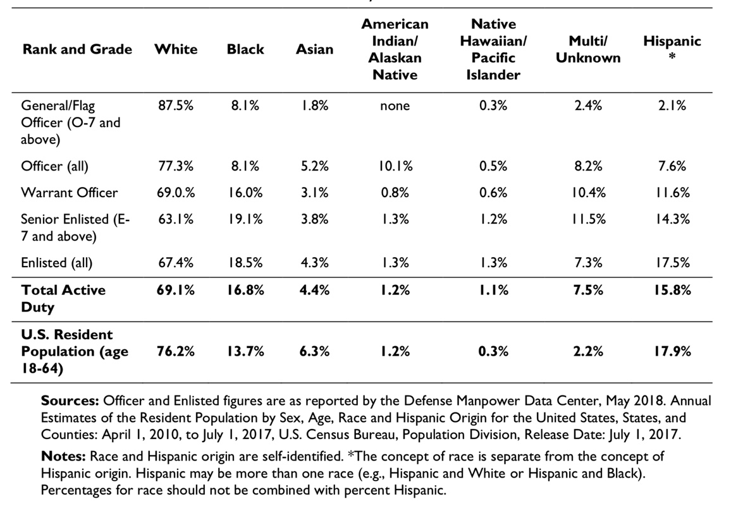
Veteran Myths
Race and Ethnic Representation in the Active Component and US Population
MYTH: The military is not very diverse
FACT: The diversity of our military is a strength and continues to change. Women are now 17% of our active duty military (up from 11% in 1990), and racial and ethnic minority groups make up >31% of the active duty military.
Bonus: As a protected employee class, they help insulate DEI programs from legal challenges brought on following the Supreme Court’s affirmative action case for college admissions this past summer.
COPYRIGHT
Notes:
MYTH: The military is not very diverse
FACT: The diversity of our military is a strength and continues to change. Women are now 16% of our active duty military (up from 11% in 1990), and racial and ethnic minority groups make up about 40% of the active duty military.

Slide 21
Question
Most veterans disabled and require expensive disability accommodations?
True
False
COPYRIGHT
Notes:
Do most veterans require disability accommodations? Yes or no?

Slide 22

Veteran Myths
MYTH: Most veterans are disabled and require expensive disability accommodations.
FACT: Most veterans are not disabled and do not require expensive disability accommodations, 58% of which cost nothing.
  <30% of employed US veterans have a service-connected disability
  58% said the accommodations needed by their employee cost absolutely nothing.
  37% experienced a one-time cost.
  3% said the accommodation resulted in an ongoing, annual cost to the company, and
  1% said the accommodation required a combination of one-time and annual costs.
  When needed, median one-time cost of accommodation was $500.
Sources: “Table 8. Employed persons 18 years and over by veteran status, presence of service-connected disability, period of service, and class of worker, August 2023, not seasonally adjusted,” US Bureau of Labor Statistics, accessed June 26, 2024, https://www.bls.gov/news.release/vet.t08.htm. “Benefits and Costs of Accommodation,” Job Accommodation Network, accessed August 31, 2022, https://askjan.org/topics/costs.cfm.
COPYRIGHT
Notes:
MYTH: Most veterans require disability accommodations, most of which are costly.
FACT: Most veterans do not require disability accommodations, 58% of which cost nothing.
58% said the accommodations needed by their employee cost absolutely nothing.
37% experienced a one-time cost.
3% said the accommodation resulted in an ongoing, annual cost to the company, and
1% said the accommodation required a combination of one-time and annual costs.
When needed, median one-time cost of accommodation was $500.

Slide 23
Question
Veterans are neither plentiful nor available.
True
False
COPYRIGHT
Notes:
True or False: Veterans are neither plentiful nor available.

Slide 24

Veteran Myths
MYTH: Veterans are neither plentiful nor available
FACT: Veterans ARE plentiful and available
  200,000 veterans matriculate into the civilian work sector annually
  Veterans are available year-round and on-demand
  Academic recruits are only available after graduation
The U.S. Department of Defense is the nation’s largest employer, with more than 3.5 million individuals – more than the employees of Amazon + McDonalds + FedEx + Target + General Electric combined.
Sources: U.S. Department of Veterans Affairs, VetPop 2007 Data, “Table 2S: Separations by State, Period, Age Group, Gender 2000-2036,” 2007. Ash Carter, Inside the Five-Sided Box: Lessons from a Lifetime of Leadership in the Pentagon (New York, NY: Random House), xi.
COPYRIGHT
Notes:
One of the main complaints I get from employers is that they don’t know where to find veterans.
Yet 200k of them enter the workforce every year
And they are available year-round, unlike academic recruits who are normally only available at the end of academic terms.

Slide 25
Question
Employers have no control over Guard or Reserve employees being activated and deployed.
True
False
COPYRIGHT
Notes:
True or False: Veterans are neither plentiful nor available.

Slide 26
Veteran Myths
MYTH: There is nothing employers can do to prevent the loss of Reserve Component (RC) members if called to active duty
FACT: This is FALSE. All employers have rights to limit the impact of such recalls.
  Employers may request that some of their workers be named “key employees” who cannot mobilize.
  By law, the Department of Defense must limit the cumulative absences of RC members.
  To educate and protect themselves, all employers should join the Employer Support of the Guard and Reserve (ESGR) organization.
  ESGR is a DoD program that promotes cooperation between RC members and their civilian employers and helps resolve conflicts arising from an employee's military commitment.
    ESGR offers several helpful employer programs.
    ESGR administers an awards program for supportive employers.
    ESGR also provides free mediation services to RC members and their employers.
  There is no obligation to continue full or differential/partial pay during an RC member’s absence, although many leading companies have such policies.
Sources: “Guidance to Screening the Ready Reserve,” Appendix A to 32 CFR 44, July 1, 2017, accessed August 31, 2022, https://www.govinfo.gov/content/pkg/CFR-2017-title32-vol1/xml/CFR-2017-title32-vol1-part44.xml. See also: “HR Professionals and Supervisors,” VA for Vets, accessed August 31, 2022, https://www.vaforvets.va.gov/vaforvets/hr/Pages/default.asp. “Department of Defense Instruction 1205.12,” U.S. Department of Defense, February 24, 2016, accessed August 31, 2022, http://www.esd.whs.mil/Portals/54/Documents/DD/issuances/dodi/120512p.pdf. “2013 Status of Forces Survey of Reserve Component Members,” Defense Manpower Data Center, March 2014, 252-260, 350-354.
COPYRIGHT
Notes:
One of the main complaints I get from employers is that they don’t know where to find veterans.
Yet 200k of them enter the workforce every year
And they are available year-round, unlike academic recruits who are normally only available at the end of academic terms.

Slide 27
Question
Do veteran hiring programs have quantifiable outcomes?
Yes
No
COPYRIGHT
Notes:
True or False: Veterans are neither plentiful nor available.

Slide 28
Veteran Myths
MYTH: Veteran Hiring Programs have no quantifiable outcomes
FACT: Veteran Hiring Programs have direct and quantifiable outcomes
The nation’s military community comprises 37 Million individuals who wield $1.2 Trillion in annual buying power
Organizations with the most inclusive and best talent management approaches have several advantages
  22% increase in productivity at organizations that create inclusive environments
  13 x higher mean cash flow from operations
  ~4 x more able to deal with personnel performance problems
  ~3 x more likely to identify and build leaders
Veterans fully employed in optimal career fields will double their career earnings, rates of retention and job satisfaction.
COPYRIGHT
Sources: Matthew J. Louis, Hiring Veterans: How to Leverage Military Talent for Organizational Growth (Newburyport, MA: Career Press, 2023). SheerID, “Marketing to the Military Explained,” Tony Coray, August 9, 2022, accessed November 30, 2022, https://www.sheerid.com/blog/marketing-to-the-military/. Mark Kaplan and Mason Donovan, The Inclusion Dividend: Why Investing in Diversity & Inclusion Pays Off (Brookline, MA: Bibliomotion, Inc., 2013), 37.
Notes:
Moreover, there are quantifiable outcomes from diversity, equity, and inclusion programs that include veterans. Organizations with successful programs realize some significant outcomes…
22% increase in productivity at organizations that create inclusive environments
13 x higher mean cash flow from operations
~4 x more able to deal with personnel performance problems
~3 x more likely to identify and build leaders
For veterans themselves, studies show that when you fully employ them in optimal career fields, …

Slide 29
Question
Hiring veterans has no direct impact on national security.
True
False
COPYRIGHT
Notes:
True or False: Hiring veterans has no direct impact on national security.

Slide 30

Veteran Myths
MYTH: Hiring veterans has no direct impact to National Security
FACT: Hiring veterans has a direct and quantifiable impact to National Security
  If military service is not seen as providing a gateway to successful civilian careers, future recruits may be dissuaded from serving. It is thus a matter of national security.
  The Department of Defense (DoD) must pay Unemployment Insurance for Ex-Servicemembers (UCX) to states whose veterans are not employed. These funds, whose amounts have varied from $200-900+ Million in recent years, subtract from DoD’s operating budget and thereby sacrifice funds that could otherwise be spent on our common defense.
Sources: Call of Duty Endowment and ZipRecruiter, “Challenges on the Home Front: Underemployment Hits Veterans Hard,” accessed August 26, 2022, https://www.callofdutyendowment.org/content/dam/atvi/callofduty/code/pdf/ZipCODE_Vet_Report_FINAL.pdf. Nathan D. Ainspan and Kristin N. Saboe, Military Veteran Employment: A Guide for the Data-Driven Leader (New York, NY: Oxford University Press, 2021), 2. See also: U.S. Congressional Budget Office, “Transitioning From the Military to the Civilian Workforce: The Role of Unemployment Compensation for Ex-Servicemembers,” May 16, 2017, Accessed December 20, 2022, https://www.cbo.gov/publication/52503.
COPYRIGHT
Notes:
Hiring veterans has a direct impact to National Security. Think about it.
If tomorrow’s recruits don’t see veterans having successful employment outcomes, they are not going to join. And as you may have heard, all services are facing recruiting shortages as we speak. The Army has gone so far to call it a crisis.
And if veterans aren’t hired, the DoD pays their unemployment, whose cost comes straight from DoD’s operating budget – funds that could be spent training our troops.

Slide 31
Question
Most organizations have veteran hiring programs in place.
True
False
COPYRIGHT
Notes:
True or False: Hiring veterans has no direct impact on national security.

Slide 32

Veteran Myths
MYTH: Most organizations have veteran hiring programs in place
FACT: Most organizations are not structured to capitalize on the opportunity
  90% of small businesses, who make up > 99% of the businesses in the country and responsible for 42% of new jobs, do NOT intentionally hire veterans
  According to a Korn Ferry survey of 700 businesses:
    80% of organizations do NOT have veteran-specific hiring programs
    71% of organizations do NOT provide talent acquisition professionals training on hiring veterans
    52% of organizations do NOT provide onboarding or transition support to veteran hires
Sources: Roy Maurer, “8 in 10 Employers Lack Recruitment Programs for Veterans,” Medium.com, May 25, 2015, accessed August 26, 2022, https://medium.com/@HRCaroline/8-in-10-employers-lack-recruitment-programs-for-veterans-3426e6ba72ae. “Small Business Index: The Voice of Small Business Owners,” Metlife & US Chamber of Commerce, Q3 2019, accessed August 26, 2022, https://www.uschamber.com/sbindex/uploads/SBI_2021_Q1.pdf.
COPYRIGHT

Slide 33
Demand & Supply of Workplace Skills
Most Important Skills Cited by Civilian Employers for Workplace Success
Professionalism / Work Ethic
Teamwork / Collaboration
Oral and written communication
Critical thinking / problem solving
Ethics / social responsibility
Skills Strengthened or Enhanced by Military Service
Work Ethic / Discipline
Leadership & management skills
Mental toughness
Adaptation to different challenges
Professionalism
Sources:
The Conference Board, Inc., the Partnership for 21st Century Skills, Corporate Voices for Working Families, and the Society for Human Resource Management, "Are They Really Ready to Work: Employer’s Perspectives on the Basic Knowledge and Applied Skills of the New Entrants to the 21st Century U.S. Workforce." 2006, accessed January 2, 2017, http://www.p21.org/storage/documents/FINAL_REPORT_PDF09-29-06.pdf.
C. Zoli, R. Maury, & D. Fay, “Missing Perspectives: Servicemembers’ Transition from Service to Civilian Life — Data-Driven Research to Enact the Promise of the Post-9/11 GI Bill,” November 2015, Institute for Veterans & Military Families, Syracuse University, accessed October 30, 2017, https://ivmf.syracuse.edu/article/missing-perspectives-servicemembers-transition-from-service-to-civilian-life/.
COPYRIGHT
Notes:
In fact, the most important skills cited by civilian employers for success in the workplace are EXACTLY the skills that are strengthened by military service. How about that?
Now that we have our facts straight, what else is preventing organizations from hiring veterans? Much of the explanation lies in what comprises the civil-military divide.

Slide 34
Support & Resources

Slide 35

“Table Stakes” Supporting Practices
Identifying
  A military-themed BRG
  Sources of military talent
Recruiting
  Dedicated recruiters
  Training materials
Interviewing / Hiring
  Trained interviewers
  Scripted question sets
Onboarding / Training
  Veterans self-identify
  Mentors and affinity groups
Deploying / Developing
  Strategic goal alignment
  Goals, feedback, and career paths
Retaining / Separating
  Reserve Component support
  Military spouses and portable careers
Source: Matthew J. Louis, Hiring Veterans: How to Leverage Military Talent for Organizational Growth (Newburyport, MA: Career Press, 2023).
COPYRIGHT

Slide 36


Interviewing & Interfacing with Veterans
Types of questions not to ask:
  What kind of discharge did you get from the military?
  When will you get deployed again?
  Have you ever killed anyone?
  Were you ever injured in combat?
  Will you have to miss much work for your National Guard or Reserve military service?
Types of questions to ask:
  What did you do in the military?
  Which of your military experiences will translate to this job?
  Tell me about a time… Give me an example…
  Will you be able to perform the duties in the job description with reasonable accommodation?
Source: Matthew J. Louis, Hiring Veterans: How to Leverage Military Talent for Organizational Growth (Newburyport, MA: Career Press, 2023).
COPYRIGHT

Slide 37
Tailor Hiring & Onboarding Process by Veteran Hire Type
Veteran Population Type
Hire without industry experience | Hire with industry experience | Hire from under-graduate school | Hire from graduate school | Retiree hire
Informal supervisor check-in
Executive Champion meeting Paired w Mentor
Formal supervisor feedback | Affinity Group Activity Formal supervisor feedback
Mentor touch-point Veterans Assimilation Training | Affinity Group Activity Veterans Assimilation Training (optional)
Mentor touch-point Informal supervisor check-in | Informal supervisor check-in Affinity Group Activity
Mentor touch-point Affinity Group Activity | Affinity Group Activity
Formal supervisor feedback | Affinity Group Activity Formal supervisor feedback
Mentor touch-point Informal supervisor check-in | Affinity Group Activity
Mentor touch-point Affinity Group Activity | Affinity Group Activity
Mentor touch-point Affinity Group Activity | Affinity Group Activity
Formal supervisor feedback | Formal supervisor feedback Affinity Group Activity
Week 1
A veteran is not a veteran is not a veteran
Establish goals early
Early, regular, substantive feedback
Mentorship
Transparency @ promotion timing & career field options
Regular tribal activities
Welcome briefing
Month 1
Onboarding training
Personal goal identification
Informal supervisor check-in
Month 2
Executive Champion meeting
Paired w Mentor (optional)
Informal supervisor check-in
Month 3
Veteran Affinity Group Briefing
Mentor touch-point (optional)
Informal supervisor check-in
Month 4
Affinity Group Activity
Month 5
Affinity Group Activity
Veterans Assimilation Training
Month 6
Mentor touch-point (optional)
Month 7
Mentor touch-point (optional)
Month 8
Affinity Group Activity
Month 9
Informal supervisor check-in
Month 10
Mentor touch-point (optional)
Month 11
Mentor touch-point (optional)
Month 12
Affinity Group Activity
Source: Matthew J. Louis, Hiring Veterans: How to Leverage Military Talent for Organizational Growth (Newburyport, MA: Career Press, 2023).
COPYRIGHT

Slide 38
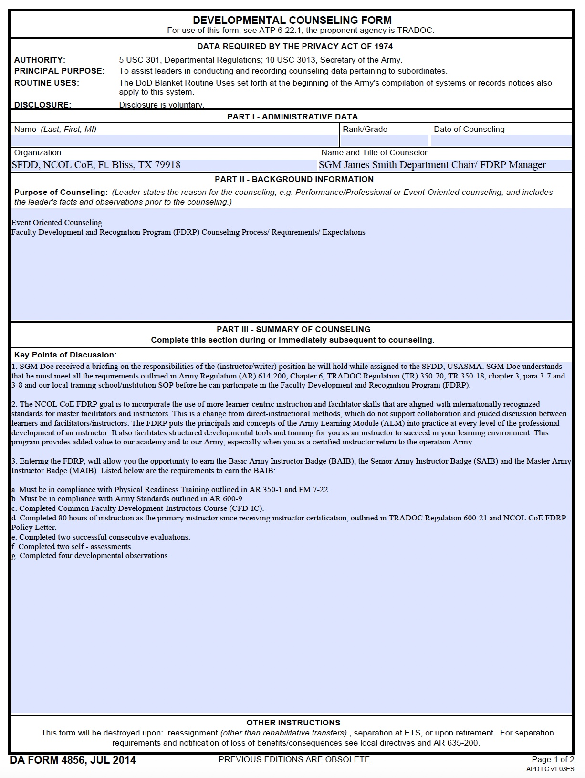
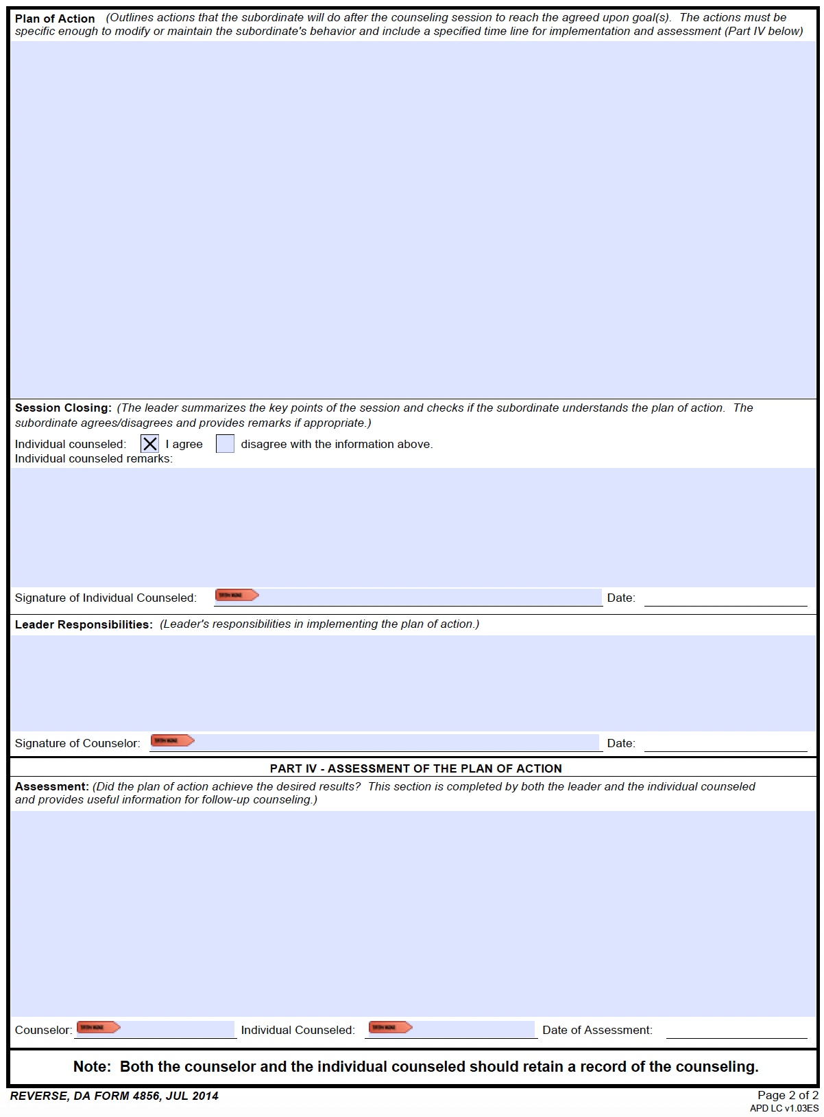
Context: Military Feedback Form & Process
Downloadable forms on my website:
https://matthewjlouis.com/hiring-veterans/sample-military-feedback-forms/.

Slide 39
Networking Assimilation Process
Initiate discussions with peers and veteran support groups both inside and outside of the workplace
Mentors and affinity group members help connect veterans with other civilian employees that are likewise educated on your background
That educated base of employees then connects veterans with the balance of the organization
The sooner that veterans assimilate using this approach, the better
Balance of the Organization
Educated Base of Employees
Mentors & Affinity Group Members
Veteran New Hires
Source: Matthew J. Louis, Hiring Veterans: How to Leverage Military Talent for Organizational Growth (Newburyport, MA: Career Press, 2023).
COPYRIGHT

Slide 40
Minimum Requirements for Success
Top-down executive-level leadership and substantive material (financial and programmatic) support
Initiation of a veteran BRG
Onboarding and mentoring programs
Direct relationship between the Veteran Support Program’s outcome-based measures and the Employer’s Strategic Goals
Compliance with all regulatory obligations (i.e., USERRA, VEVRAA, ADA, FMLA, etc.)
  Where applicable, compliance with the Office of Federal Contract Compliance Program (OFCCP)
Sample Veteran Support Program Reporting Dashboard
Source: Matthew J. Louis, Hiring Veterans: How to Leverage Military Talent for Organizational Growth (Newburyport, MA: Career Press, 2023). Also, “Cultivating veteran communities: Building collaborative networks to support military family transitions,” Matthew J. Louis & Nate Pelletier, Deloitte & TVCA, 2018, accessed April 21, 2020, https://matthewjlouis.com/media/cultivating-veteran-communities-building-collaborative-networks-to-support-military-family-transitions/.

Slide 41

Additional Keys to Success
Support focused hiring efforts on veterans of all backgrounds, as well as their spouses. Support military spouse employment with child care options and flexible schedules.
Leverage the veterans you already have in-house in doing all of the above (i.e., internal referrals, mentoring, BRG leadership, training leads, etc.)
Utilize Purepost, the best way to match talent to your open requirements (www.purepost.co)
Encourage veterans to self-identify & read Mission Transition
Educate your employees @ veterans, especially managers and peers of veteran hires
Train recruiters and interviewers of veterans. Have them read Hiring Veterans.
Make the culture of your organization transparent to veteran candidates.
Leverage apprenticeship or rotational onboarding programs and Veteran Collaboratives
Team with ESGR and leverage their support of your Reserve Component employees
Identify relevant events (Veterans Day, Memorial Day, etc.) and celebrate success
Apply to all applicable military initiative recognition programs and for applicable tax incentives
Incorporate an experienced external advisor to enable your program’s success
Source: Matthew J. Louis, Hiring Veterans: How to Leverage Military Talent for Organizational Growth (Newburyport, MA: Career Press, 2023).
COPYRIGHT

Slide 42
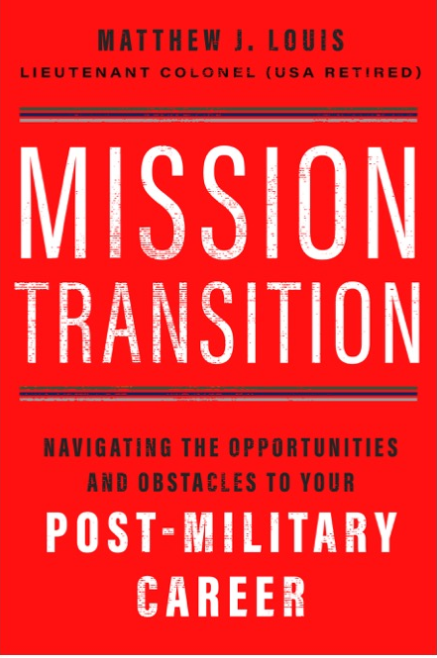


Do…
Watch this PsychArmor video:
15 Things Veterans Want You to Know
Thank military members for their service, but remember to thank their families. Kids and spouses make huge sacrifices to support their deployed family member.
Send deployed service members cards and care packages. They really enjoy getting them.
Acknowledge people who have been deployed. Say something to the service members themselves, like “It’s so good to see you home with us again. What are you up to this weekend?” or to their family, “I know your son was deployed last year, and I’m so happy he’s back home now,” or “I know your uncle died in combat, and I’m so very sorry for your loss.”
Be available to talk and listen about things in general, including the important aspects of returning to everyday life—job, hobbies, activities, etc. A simple, “How are you doing” or “How’s the job search going?” can be very comforting.
Engage in community activities. Some military members return to a huge network of friends and family; others do not. Arrange outings to baseball games, museums, or the movies.
Offer help in specific ways. Rather than saying “Let me know if I can help…” say, “I’d like to babysit for you this weekend—you deserve a night out.”
Help them feel like their service matters
Ensure them that, though the transition to the real world is difficult, there is a place for them
Offer a job if you or someone you know is hiring.
Encourage the use of:
  My books and my website
  Purepost Passports
  Veteran Collaboratives
  Internships or Apprenticeships

Slide 43
Don’t…
Assume all veterans served in a combat capacity
Ask for specific details about combat (for the few that did serve in a combat capacity)
Ask a military member if he/she has shot or killed someone
Discuss politics or other current events involving combat
Confuse branches of the military
  Army = Soldiers
  Navy = Sailors
  Marines = Marine
  Air Force = Airmen/women
  Space Force = Guardians
  When in doubt, use the terms “service member”, “military”, or “veteran”, which apply to all branches

Slide 44
But Wait, There’s More

Slide 45
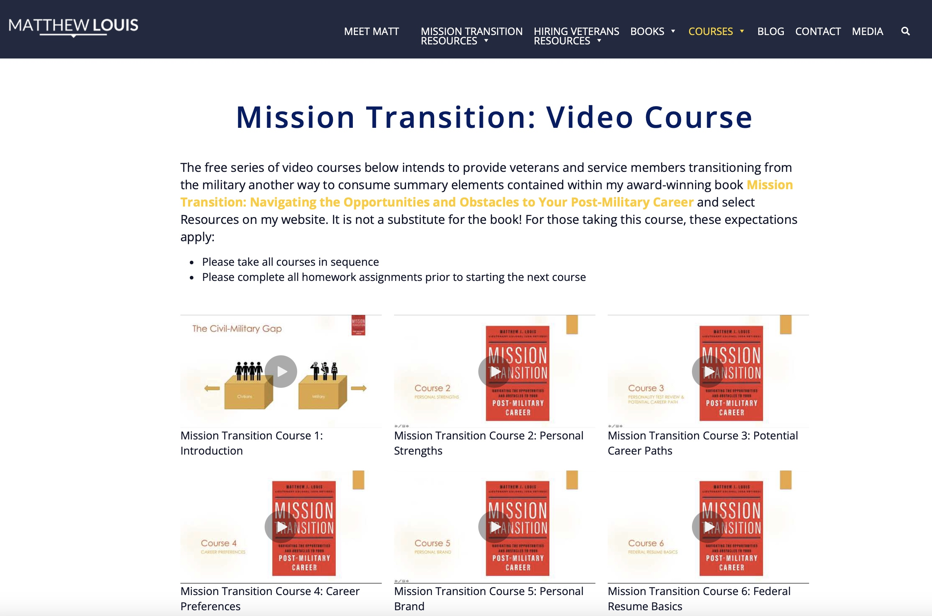
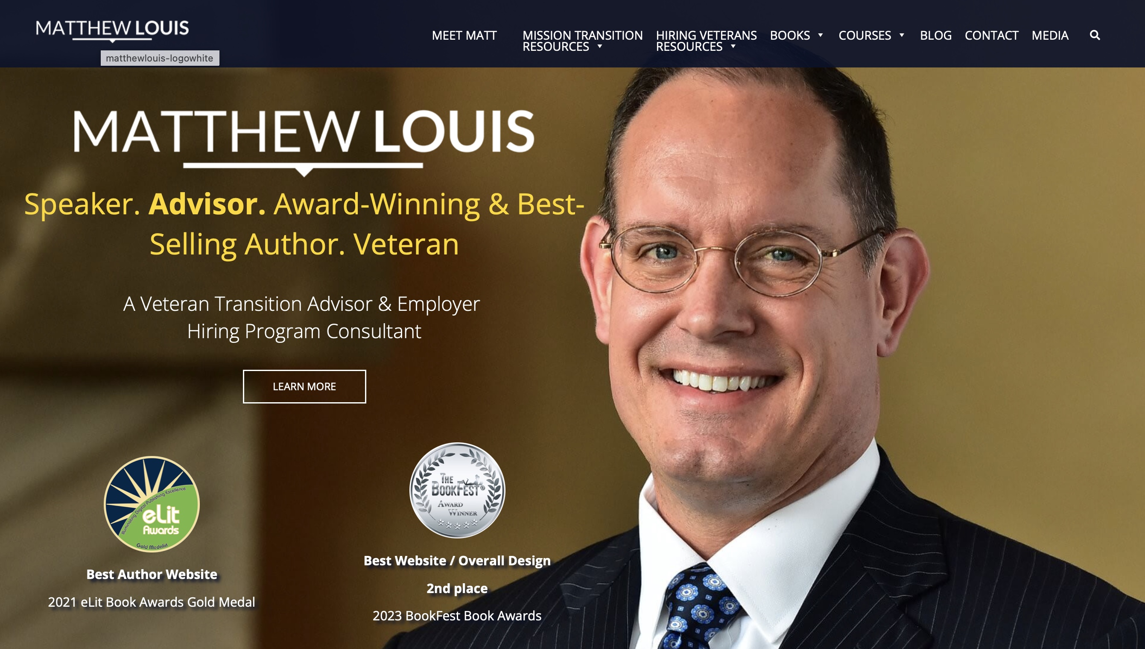
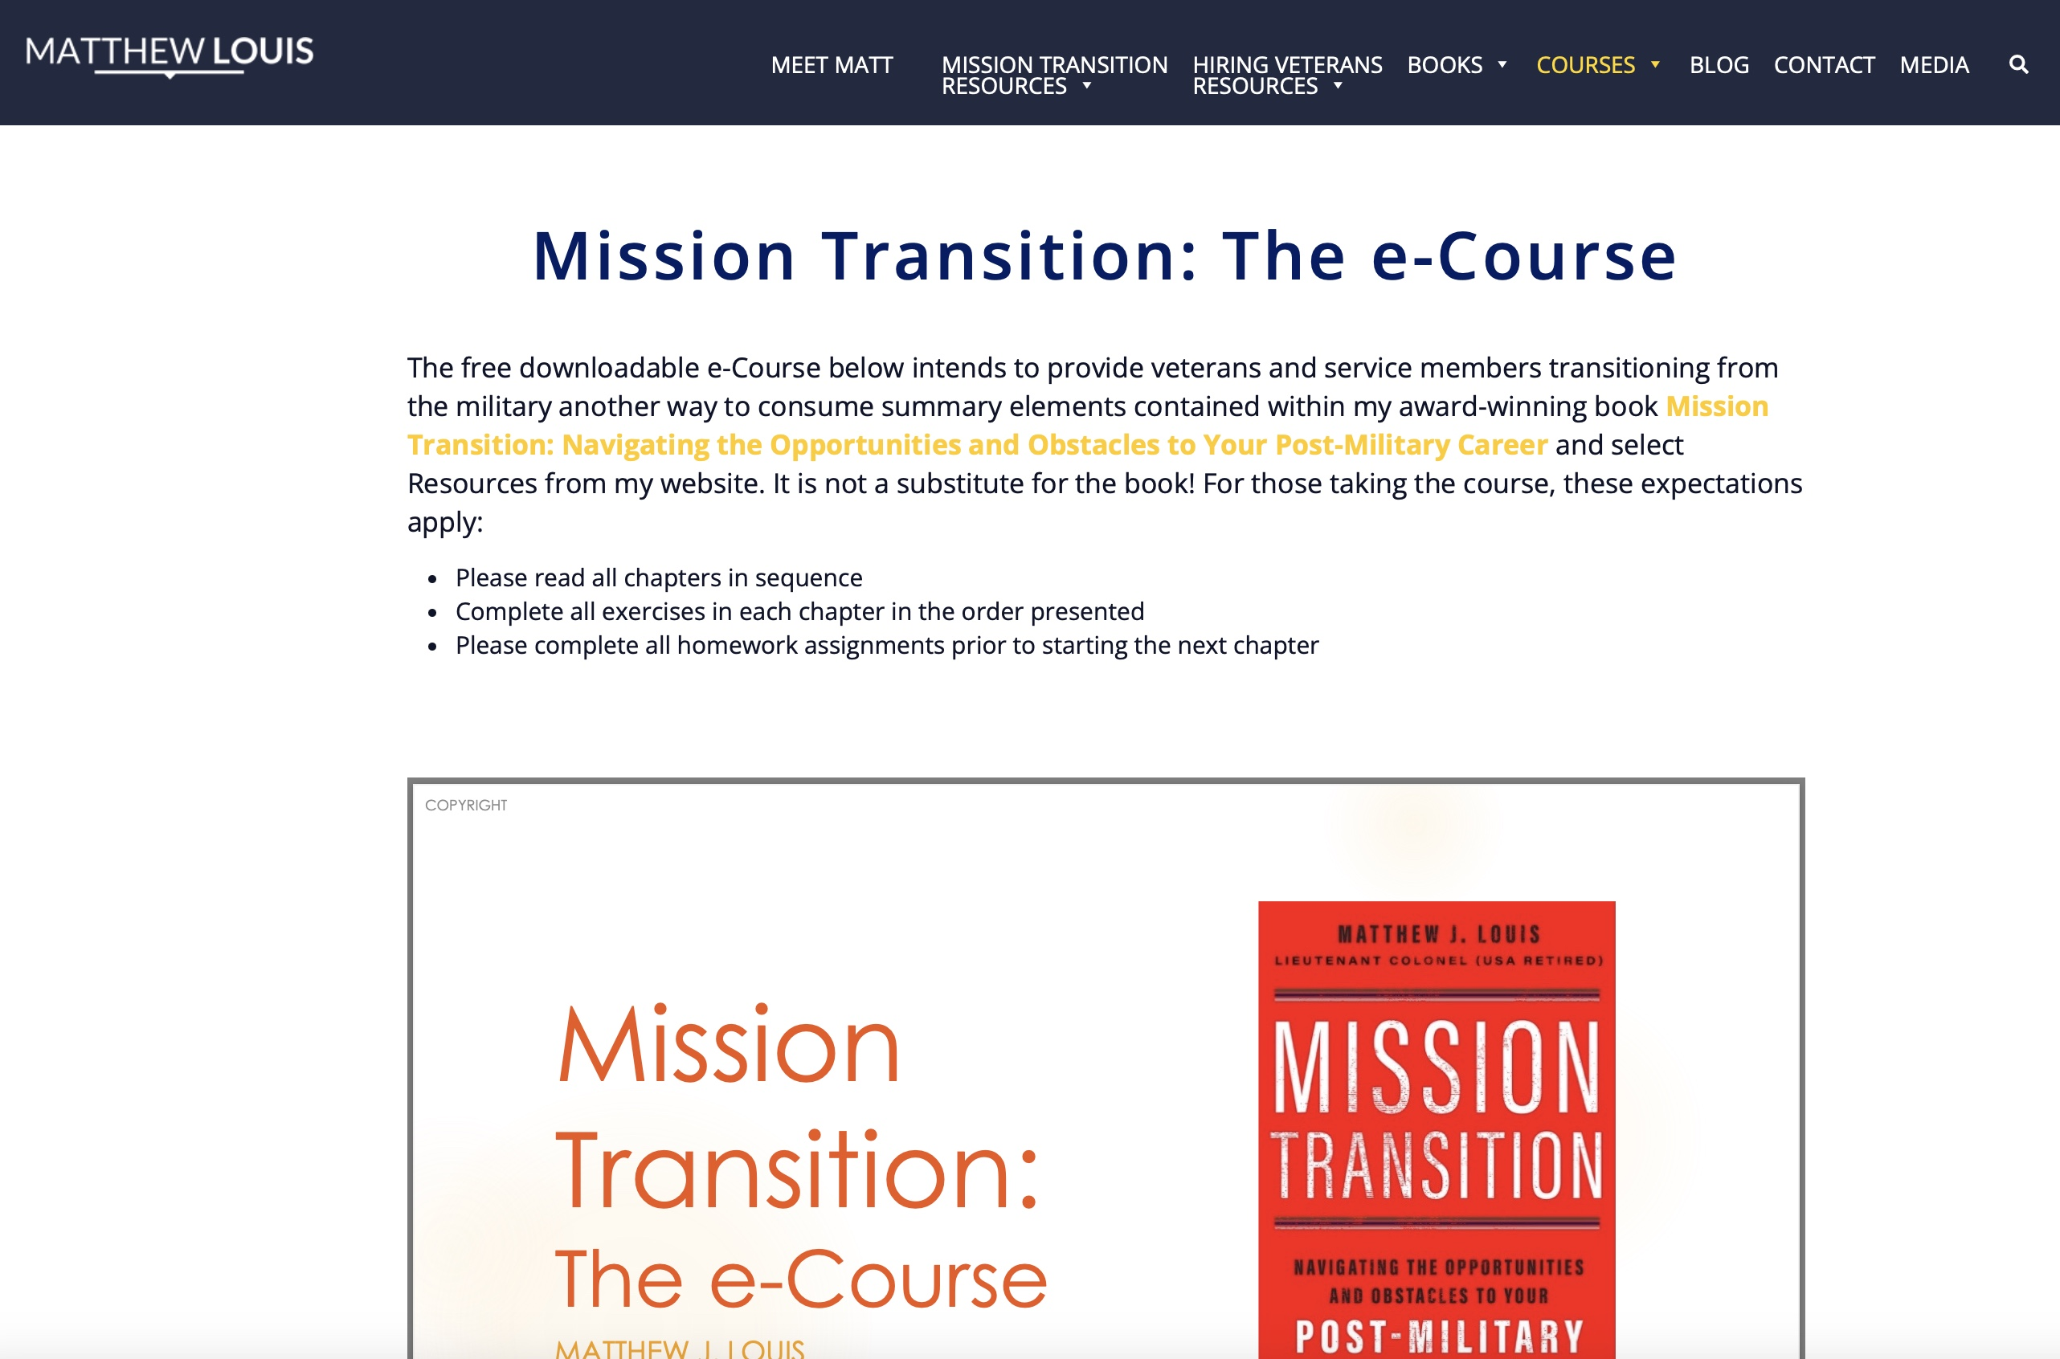
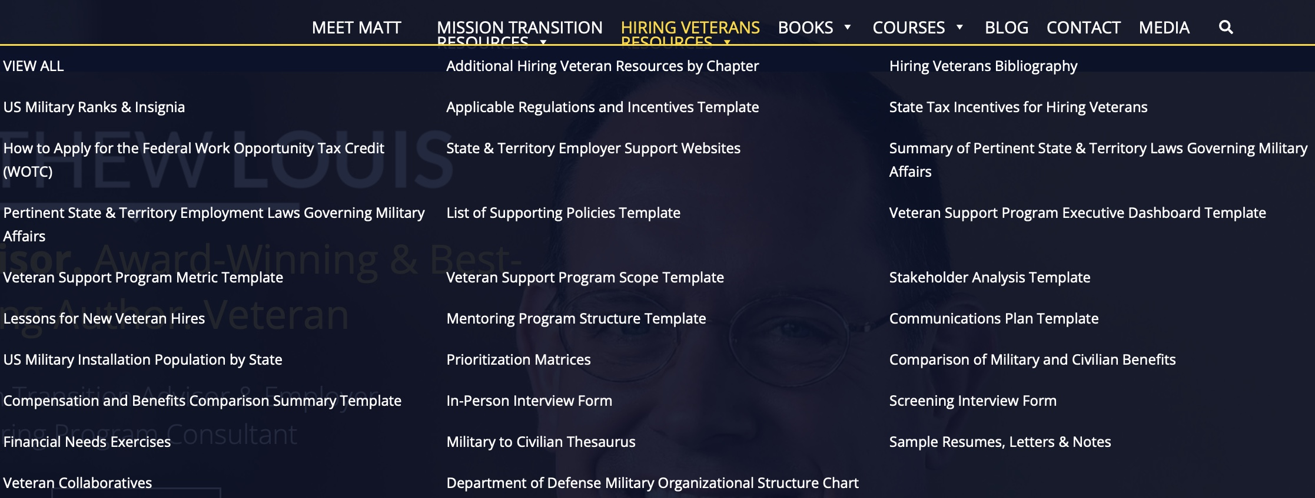


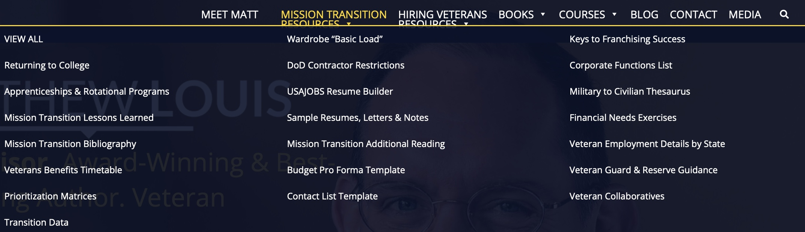
My Website www.matthewjlouis.com
Free Courses
Free Resources
21 free video courses; free e-course
Tons of free resources
  Thorough Military-to-Civilian thesaurus
  Resume / Letter templates
  Financial needs exercises
  Repository for lessons learned
  Additional Reading & Guidance (RC/Guard)
  Interactive tools
COPYRIGHT
Notes:
I mentioned my website several times. Please check it out at MatthewJLouis.com
I have a bunch of valuable free resources for you.

Slide 46





Purepost Services & Who We Serve
Create Passport, Upskill, Get Hired
Build Profile in 10 mins
Acquire Talent
Find Talent in 10 mins
Supply Meets Demand
Who Benefits:
Who Benefits:
U.S. Military Veterans
Any Job Seeker
Small & Medium Sized Businesses
Enterprises
Manpower Organizations
Who Benefits:
Case Manage Job Seekers
Veteran Service Orgs
Technical Schools
College and University Career Centers
Talent Networks (ERGs)
State Workforce Agencies
Optimally Deploy Internal Talent
Who Benefits:
Any organization

Slide 47
Closing Thoughts

Slide 48


Thank You!
Matt@matthewjlouis.com
www.matthewjlouis.com
www.purepost.co
Matthew J. Louis
Louis Advisors, LLC
A Veteran-Owned Small Business
513-314-9870 (mobile)
COPYRIGHT
Notes:
If you’d like to get a hold of me, here is where you can reach me.

Slide 49
Backup Slides

Slide 50
Hiring Veterans: The Assimilation Process
Understand veterans and military culture
Create support program content
Decision to support veteran hires
Interview & Decide on Hire
Identify & Recruit candidates
Finalize offer
Onboard, Deploy & Retain veteran hires
Validate Assimilation & Measure Success
Organize & staff veteran support program
Set expectations internally & externally
Time (measured in months)
Scope includes the entire employment lifecycle:
Re-Deploy
Recruit
Interview
Hire
Onboard / Train
Deploy / Develop
Retain / Separate
Identify
Re-Train
Source: Matthew J. Louis, Hiring Veterans: How to Leverage Military Talent for Organizational Growth (Newburyport, MA: Career Press, 2023).
COPYRIGHT

Slide 51
Scope of a Veteran Support Program (i.e., What Does Being Military- or Veteran-Friendly Mean?)
Training & Cultural
Awareness
Education
& Preferences
Internal Policies / Functions
Personnel
Value Chain
Corporate Philanthropy
Employee Assistance
Affinity Group / Mentors
Employment Lifecycle
Family Members
Veterans
Spouses
Enlisted
Officers
Guard & Reserve
Civilians
Suppliers
Sales policies (i.e., veteran discounts)
Community Members
Veteran Service Organizations
Chambers of Commerce
Internal to the Organization
External to the Organization
Source: Matthew J. Louis, Hiring Veterans: How to Leverage Military Talent for Organizational Growth (Newburyport, MA: Career Press, 2023).
COPYRIGHT

Slide 52





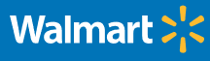





Case Studies
JPMorgan Chase
Prudential
Amazon
P&G
Wal-Mart
Tesla
USAA
ADP
Schlumberger
Cajun Industries
Performance Contractors
State Department
Xavier University

