Slide 1


The Importance of Successful Military Transitions
Matthew J. Louis
Louis Advisors LLC
April 2025
Copyright

Slide 2


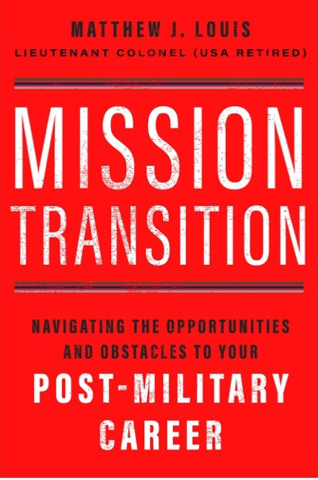
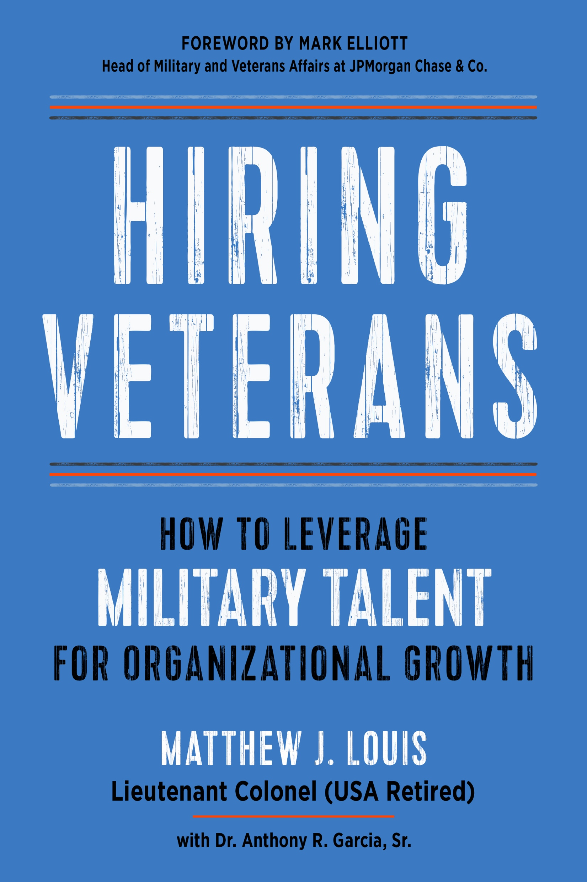



















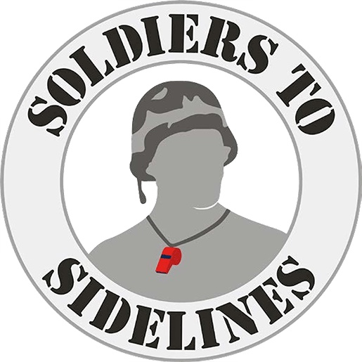










Matt Louis – Career on One Page
Mission: Eliminating the civil-military divide in the US
25 Years in uniform
27 Years+ in the corporate world
Career History
Louis Advisors LLC
Previous Employers
1991
1996
1998
2004
2005
2006
2009
2012
2015
2018
2021
2022
2023
Not To Scale
COPYRIGHT

Slide 3
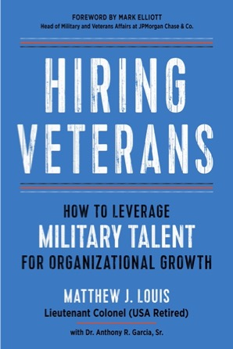
Hiring Veterans
My Assertion
Notes:
My explanation for the basis in these difficulties lies in what I call the civil-military gap.
So let’s start with a definition.

Slide 4
Our Agenda
Our nation faces an unprecedented security crisis
The civil-military divide is a major cause of that crisis
  It stifles successful transitions from the military
  It constrains full employment in optimal career fields
    …both of which continuously negatively reinforce the divide
    …and drive a vicious circle
There is something everyone in this room can do to help resolve this crisis
COPYRIGHT

Slide 5
Hiring Veterans
The Problem
Notes:
My explanation for the basis in these difficulties lies in what I call the civil-military gap.
So let’s start with a definition.

Slide 6
A National Security Crisis
FY2023 Active-duty Military Recruiting Shortfalls
Service | FY 2023 Recruiting Goal | FY 2023 Recruiting Shortfall
Army | 65,000 | 10,000 (15%)
Navy | 38,000 | 7464 (20%)
Air Force | 27,000 | 2700 (10%)
Military recruiting shortfalls
  All services (-Marines) missed recruiting goals in recent years
  Army: cut its active-duty end strength 5%; the smallest it’s been since before World War II
  Navy: Military Sealift Command will sideline 13.6% of its ships due to manpower shortages
  Only 9 percent of young Americans said they would consider military service
  Only 23 percent of 17-24 year-olds qualify to serve
The suicide rate among post-9/11 veterans more than doubled between 2006-2016, with no end in sight
There is a direct correlation between suicidality and un-/under-employment in post-9/11 veterans
  53% of separating post-9/11 veterans will face a period of unemployment averaging 22 weeks
  ~63% of vets’ first jobs are NOT in their chosen career field; average time in those roles is 1.56 years
  ~50% are still not in a job in their preferred career field by their SIXTH post-military job
    Employers: Why hire people that appear to be mentally unstable?
    Recruits: Why join an organization that creates mentally unstable people that end up under-employed?
How could this possibly be?
COPYRIGHT

Slide 7
Hiring Veterans
Veteran Talent Value Proposition

Slide 8
Question:
Are veterans more or less educated than their civilian peers?
Statistic | Veterans | Non-Veterans
% with High School Degree | 96.4% | 90.6%
MORE
LESS
COPYRIGHT

Slide 9
Are veterans more or less educated than their civilian peers?
Statistic | Veterans | Non-Veterans
% with High School Degree | 96.4% | 90.6%
Source: U. S. Department of Labor, Bureau of Labor Statistics, Current Population Survey, Table 3: Employment status of persons 25 years and over by veteran status, period of service, and educational attainment, 2021 annual averages. https://www.bls.gov/news.release/vet.t03.htm. Accessed August 26, 2022.
COPYRIGHT

Slide 10
Question:
By what percentage are veterans more likely than non-veterans to have a graduate or other advanced degree?
160%
…and veterans with bachelor’s degrees have 3X more work experience than non-veterans
<50%
50 – 100%
>100%
Sources: Melissa Boatwright and Sarah Roberts, “Veteran Opportunity Report: Understanding an untapped talent pool,” LinkedIn, accessed September 1, 2022, https://socialimpact.linkedin.com/content/dam/me/linkedinforgood/en-us/resources/veterans/LinkedIn-Veteran-Opportunity-Report.pdf.
COPYRIGHT

Slide 11
Question:
By what percentage are veterans more likely than non-veterans to have a graduate or other advanced degree?
160%
…and veterans with bachelor’s degrees have 3X more work experience than non-veterans
Sources: Melissa Boatwright and Sarah Roberts, “Veteran Opportunity Report: Understanding an untapped talent pool,” LinkedIn, accessed September 1, 2022, https://socialimpact.linkedin.com/content/dam/me/linkedinforgood/en-us/resources/veterans/LinkedIn-Veteran-Opportunity-Report.pdf.
COPYRIGHT

Slide 12
Veterans Bring Significant Education and Experience
Rank | Education | Military Role | Military Training | Transferable Skill Sets | Military Personnel Supervised | Equivalent Civilian Role | Civilian Personnel Supervised
O-7 – O-10 | Advanced Degree | Enterprise leader Coalition Leader (Joint Services, Interagency, International) | Advancer Senior Leader Education Joint Chiefs of Staff Education | Strategic Planning National Policy implementation Enterprise Policy development Advising Elected Officials | 10,000+ | CXO (CEO, COO, CFO, CIO, etc.) | 1000+
O4 – O-6 / W4 – W5 | Advanced Degree | Large Unit Leader Staff Commander | War College Command & General Staff College | Advanced leadership Organizational Controls Policy Development Long-term planning | 3000+ (O-6) 1000+ (O-5) | President, Vice President | 600+
O-1 – O-3 / W-1 – W-3 | Undergraduate Degree | Small unit leader | Officer Basic & Advanced Training Technical Schools | Tactical planning Team building Basic leadership Mentoring Operational experience Organizational administration | 150 (O-3) 40 (O-1/2) | Director, Operations Manager, Business Analyst, Engineer | ~250 30 16 8
E7 – E9 | Undergraduate Degree | Large-Size Unit Leader Senior Staff Leader / Member | Advanced professional and advisor courses | Strategic Management Advanced advisory Organizational administration | 200+ (E-9) 40-200 (E-7/8) | Supervisor | 8-40
E5 – E6 | Undergraduate Degree or High School / GED | Small unit leader | Basic leadership & technical schools | Basic leadership Team building Coaching | 10-60 | Team Leader | 3-12
E1 – E4 | High School / GED | Member of team | Basic training & technical schools | Teamwork Performance under pressure Accountability Honesty, loyalty | 0 | Analyst Programmer Generalist Specialist | 2 1 1 0
Source: Matthew J. Louis, Hiring Veterans: How to Leverage Military Talent for Organizational Growth (Newburyport, MA: Career Press, 2023).
COPYRIGHT
Notes:
Fact of the matter is Veterans Bring Significant Education and Experience…
See the red rectangle. These tend to be the typical ranks that organizations recruit from the military. I suspect most of you fall within that rectangle.
If you compare your military training, education, and supervisory responsibilities to that of your civilian peers, you’ll see the differences are quite stark.
Now that’s not to say that an Army captain can step immediately into a Director role in a business. Absolutely not.
That would be like saying that business Director could step immediately into the role of an Army company commander. That just doesn’t work.
There needs to be some transition, some training, some assimilation before an individual could assume such roles. We will talk about that later.

Slide 13
Question:
What percentage of veterans served in a combat specialty?
<15%
0 – 25%
25 – 50%
50 – 75%
COPYRIGHT

Slide 14
Question:
What percentage of veterans served in a combat specialty?
<15%
0 – 25%
25 – 50%
50 – 75%
COPYRIGHT

Slide 15
Veterans Bring Significant Transferable Skills
Occupational Specialties | Army | Air Force | Coast Guard | Marines | Navy | Personnel per Occupational Specialty
Administrative | 6,140 | 14,046 | 1,507 | 12,018 | 18,635 | 52,346 | 4.8%
Combat Specialty | 109,625 | 677 | 649 | 39,850 | 8,388 | 158,689 | 14.5%
Construction | 15,313 | 5,195 | - | 6,252 | 3,987 | 30,747 | 2.9%
Electronics | 31,051 | 29,310 | 4,341 | 16,822 | 48,236 | 129,760 | 11.7%
Engineering | 43,567 | 49,162 | 1,256 | 26,917 | 39,611 | 160,513 | 14.5%
Healthcare | 29,986 | 15,441 | 707 | - | 25,345 | 71,479 | 6.4%
Human Resources | 16,558 | 7,720 | 1 | 2,214 | 3,941 | 30,434 | 2.8%
Machine Operator | 4,107 | 6,063 | 1,688 | 2,539 | 8,542 | 22,939 | 2.1%
Media and PR | 6,646 | 7,095 | 136 | 2,439 | 3,859 | 20,175 | 1.9%
Protective Service | 21,802 | 32,573 | 2,720 | 6,096 | 12,011 | 75,202 | 6.8%
Support Service | 9,901 | 4,981 | 1,145 | 2,263 | 8,129 | 26,419 | 2.5%
Transportation / Logistics | 48,096 | 27,840 | 9,879 | 23,213 | 37,709 | 146,737 | 13.4%
Vehicle / Machine Mechanic | 45,344 | 41,555 | 5,532 | 21,511 | 47,353 | 161,295 | 14.6%
Unspecified Code | 2,984 | 5,038 | 1,439 | 1,161 | 2,555 | 13,177 | 1.1%
Total | 391,120 | 246,696 | 31,000 | 162,795 | 268,301 | 1,099,912 | 100.0%
Bonus fact:
The largest group of individuals in the country with security clearances is in the military
COPYRIGHT
Notes:
Check out this table. I’ve circled the percentage of service members that serve in a combat specialty. Now, let’s flip that figure on it’s head…
85% of military occupational specialties are in career fields that have directly transferable skills – think of engineers, construction, technology, healthcare, human resources, logistics, etc.
I was unfortunately one of those trigger pullers that represent the 15%. I was a tanker. The good news is that we don’t have Abrams tanks rolling down our streets. The bad news is that meant I needed to recreate myself.
Some of you may fall into that group as well. If you do, just know that you will need a little more time to self-reflect, uncover your transferable skills, and reinvent yourself.

Slide 16
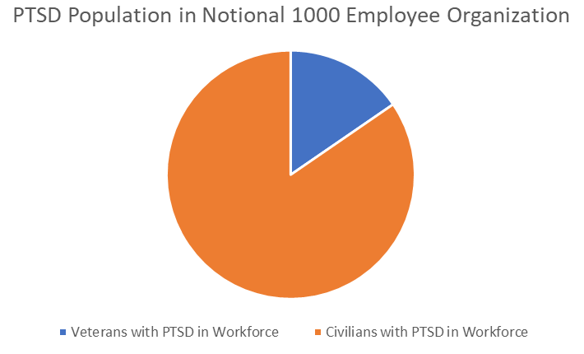
Question:
Veteran Myths
MYTH: Veterans are disproportionately affected by Post-Traumatic Stress
FACT: There are more than five times the number of civilians in your organization that have PTSD
Notional 1000—person organization
What portion of an employee population has a greater percentage of PTSD?
Veterans | Non-veterans
6% of veterans in labor pool 1000 x (6%) = 60 veteran employees | 1000 – 60 veteran employees = 940 non-veteran employees
11-20% of post-9/11 veterans have PTSD 20% x (60) = 12 veteran employees with PTSD | 7-8% of the adult US population will have PTSD 7% x (940) ~ 66 civilian employees with PTSD
Veterans
Non-Veterans
COPYRIGHT

Slide 17
Veteran Myths
MYTH: Veterans are disproportionately affected by Post-Traumatic Stress
FACT: There are more than five times the number of civilians in your organization that have PTSD
Notional 1000—person organization
Veterans | Non-veterans
6% of veterans in labor pool 1000 x (6%) = 60 veteran employees | 1000 – 60 veteran employees = 940 non-veteran employees
11-20% of post-9/11 veterans have PTSD 20% x (60) = 12 veteran employees with PTSD | 7-8% of the adult US population will have PTSD 7% x (940) ~ 66 civilian employees with PTSD
COPYRIGHT

Slide 18
Question:
Is the military diverse?
Yes
No
COPYRIGHT

Slide 19
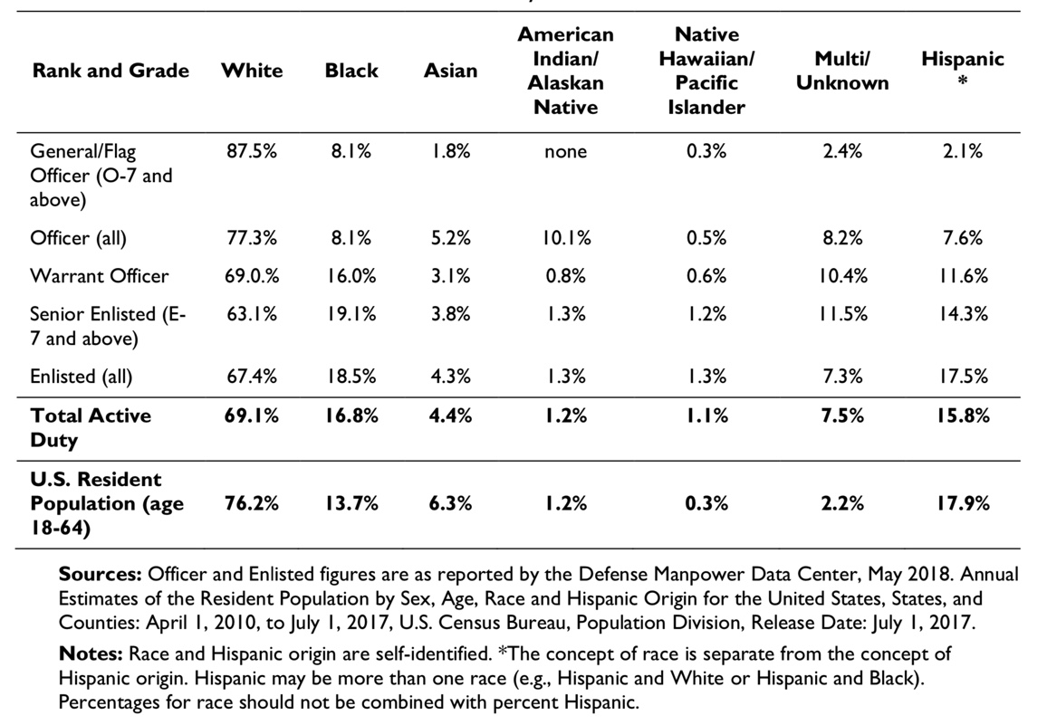
Veteran Myths
Race and Ethnic Representation in the Active Component and US Population
MYTH: The military is not very diverse
FACT: The diversity of our military is a strength and continues to change. Women are now 17% of our active-duty military (up from 11% in 1990), and racial and ethnic minority groups make up >31% of the active-duty military.
COPYRIGHT

Slide 20
Question:
Most veterans are disabled and require expensive disability accommodations?
Yes
No
COPYRIGHT

Slide 21

Veteran Myths
MYTH: Most veterans require disability accommodations, most of which are costly.
FACT: Most veterans are not disabled and do not require expensive disability accommodations, 58% of which cost nothing.
  <30% of employed US veterans have a service-connected disability
  58% said the accommodations needed by their employee cost absolutely nothing.
  37% experienced a one-time cost.
  3% said the accommodation resulted in an ongoing, annual cost to the company, and
  1% said the accommodation required a combination of one-time and annual costs.
  When needed, median one-time cost of accommodation was $500.
COPYRIGHT

Slide 22
Veterans are neither plentiful nor available.
True
False
COPYRIGHT

Slide 23

Veteran Myths
MYTH: Veterans are neither plentiful nor available
FACT: Veterans ARE plentiful and available
  200,000 veterans matriculate into the civilian work sector annually
  Veterans are available year-round and on-demand
  Academic recruits are only available after graduation
The U.S. Department of Defense is the nation’s largest employer, with more than 3.5 million individuals – more than the employees of Amazon + McDonalds + FedEx + Target + General Electric combined.
COPYRIGHT

Slide 24
Employers have no control over Guard or Reserve employees being activated and deployed.
True
False
COPYRIGHT

Slide 25
Veteran Myths
MYTH: There is nothing employers can do to prevent the loss of Reserve Component (RC) members if called to active duty
FACT: This is FALSE. All employers have rights to limit the impact of such recalls.
  Employers may request that some of their workers be named “key employees” who cannot mobilize.
  By law, the Department of Defense must limit the cumulative absences of RC members.
  To educate and protect themselves, all employers should join the Employer Support of the Guard and Reserve (ESGR) organization.
  ESGR is a DoD program that promotes cooperation between RC members and their civilian employers and helps resolve conflicts arising from an employee's military commitment.
    ESGR offers several helpful employer programs.
    ESGR administers an awards program for supportive employers.
    ESGR also provides free mediation services to RC members and their employers.
  There is no obligation to continue full or differential/partial pay during an RC member’s absence, although many leading companies have such policies.
COPYRIGHT

Slide 26
Question:
Do veteran hiring programs have quantifiable outcomes?
Yes
No
COPYRIGHT

Slide 27

Veteran Myths
MYTH: Veteran Hiring Programs have no quantifiable outcomes
FACT: Veteran Hiring Programs have direct and quantifiable outcomes
The nation’s military community comprises 37 Million individuals who wield $1.2 Trillion in annual buying power
Organizations with the most inclusive and best talent management approaches have several advantages
  22% increase in productivity at organizations that create inclusive environments
  13 x higher mean cash flow from operations
  ~4 x more able to deal with personnel performance problems
  ~3 x more likely to identify and build leaders
Veterans fully employed in optimal career fields will double their career earnings, rates of retention, and job satisfaction.
COPYRIGHT

Slide 28
Hiring veterans has no direct impact on national security.
True
False
COPYRIGHT

Slide 29

Veteran Myths
MYTH: Hiring veterans has no direct impact to National Security
FACT: Hiring veterans has a direct and quantifiable impact to National Security
  Full time employment directly offsets all other veteran social determinants of health issues and is directly correlated to lower suicidality in the post-9/11 veteran cohort.
  If military service is not seen as providing a gateway to successful civilian careers, future recruits may be dissuaded from serving. It is thus a matter of national security.
  The Department of Defense (DoD) must pay Unemployment Insurance for Ex-Servicemembers (UCX) to states whose veterans are not employed. These funds, whose amounts have varied from $200-900+ Million in recent years, subtract from DoD’s operating budget and thereby sacrifice funds that could otherwise be spent on our common defense.
COPYRIGHT

Slide 30
Most organizations have veteran hiring programs in place.
True
False
COPYRIGHT

Slide 31
Veteran Myths
MYTH: Most organizations have veteran hiring programs in place
FACT: Most organizations are not structured to capitalize on the opportunity
  90% of small businesses, who make up > 99% of the businesses in the country and responsible for 42% of new jobs, do NOT intentionally hire veterans
  According to a Korn Ferry survey of 700 businesses:
    80% of organizations do NOT have veteran-specific hiring programs
    71% of organizations do NOT provide talent acquisition professionals training on hiring veterans
    52% of organizations do NOT provide onboarding or transition support to veteran hires
…and yet…
COPYRIGHT

Slide 32
Business Value of Veterans
VA: “a person who served in the active military, naval, or air service, and who was discharged or released therefrom under conditions other than dishonorable.”
Entrepreneurial
Assume high levels of trust
Adept at skill transfer across contexts/tasks
Have advanced technical training
Comfortable/adept in discontinuous environments
High levels of resilience
Advanced team-building skills
Strong organizational commitment
Have had cross-cultural experiences
Experience/skill in diverse work settings
Promoted faster
Perform better
Easier to manage
…than their non-veteran peers
COPYRIGHT
Notes:
Amy Shafer et al., “Onward and Upward: Understanding Veteran Retention and Performance in the Workforce,” Center for a New American Security, November 2016.

Slide 33
Demand & Supply of Workplace Skills
Most Important Skills Cited by Civilian Employers for Workplace Success
Professionalism / Work Ethic
Teamwork / Collaboration
Oral and written communication
Critical thinking / problem solving
Ethics / social responsibility
Skills Strengthened or Enhanced by Military Service
Work Ethic / Discipline
Leadership & management skills
Mental toughness
Adaptation to different challenges
Professionalism
So what is getting in the way?
COPYRIGHT

Slide 34
Hiring Veterans
Why The Problem Exists
Notes:
My explanation for the basis in these difficulties lies in what I call the civil-military gap.
So let’s start with a definition.

Slide 35
The Civil-Military Divide – A Definition
A lack of understanding between…
  The nation’s civilian population and
  Those who serve in the all-volunteer military
Characterized by issues along multiple dimensions
  Geographic
  Demographic
  Cultural
  Social
Driven by many root causes
  Incomplete/poor transitions from military service
  Lack of coordinated support systems
Exacerbated by opposing attitudes
  Pity from the public
  A sense of superiority from the military
This drives a fundamental disconnect between what veterans expect of employers and what employers expect of veterans
COPYRIGHT
Notes:
A widening divide between the nation and those who serve her
Characterized by issues among multiple dimensions
Driven by many root causes – to include failed transitions from the military and lack of coordinated support systems
Exacerbated by opposing attitudes from both the public and the military
This drives a fundamental disconnect between what veterans expect of employers and what employers expect of veterans

Slide 36



The Civil-Military Divide Illustrated
Civilians
Military
COPYRIGHT
Notes:
I’m a visual learner. Allow me to paint this picture in a bit more detail.

Slide 37
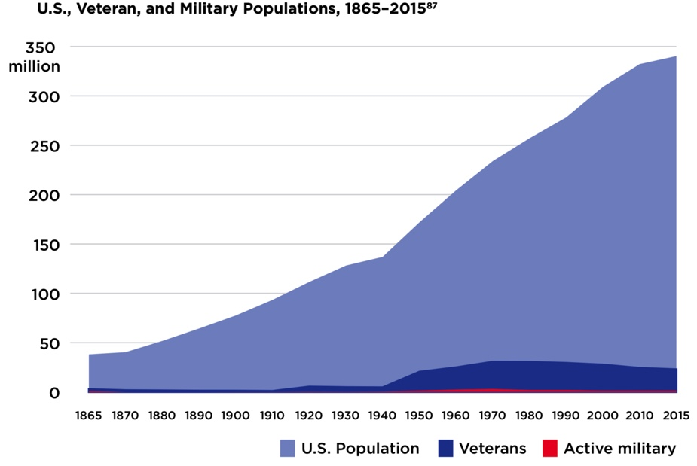
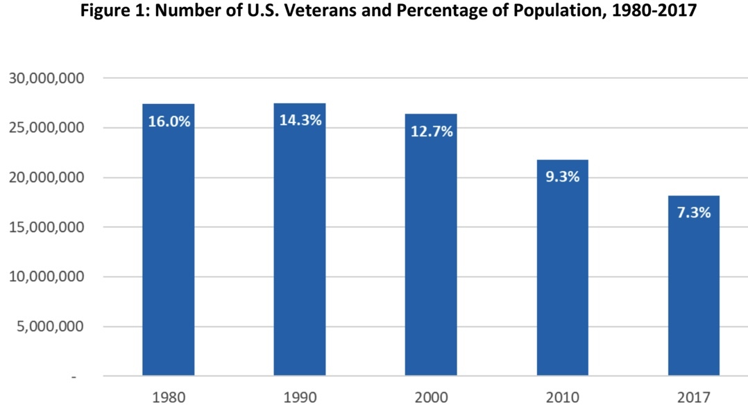
Veterans make up less than half the % of the US population they did a generation ago
Sources: (Above) Phillip Carter, Amy Schafer, Katherine Kidder and Moira Fagan, “Lost in Translation: The Civil-Military Divide and Veteran Employment,” Center For a New American Security, June 15, 2017, 2.
(Right) Texas Workforce Investment Council, “Veterans in Texas: A Demographic Study,” September 2019, 4.
COPYRIGHT
Notes:
Veterans make up less than half the % of the US population they did a generation ago.
It’s a simple matter of the US population growing while the veteran population remains relatively steady.
But, percentage-wise, there are fewer of us around.

Slide 38
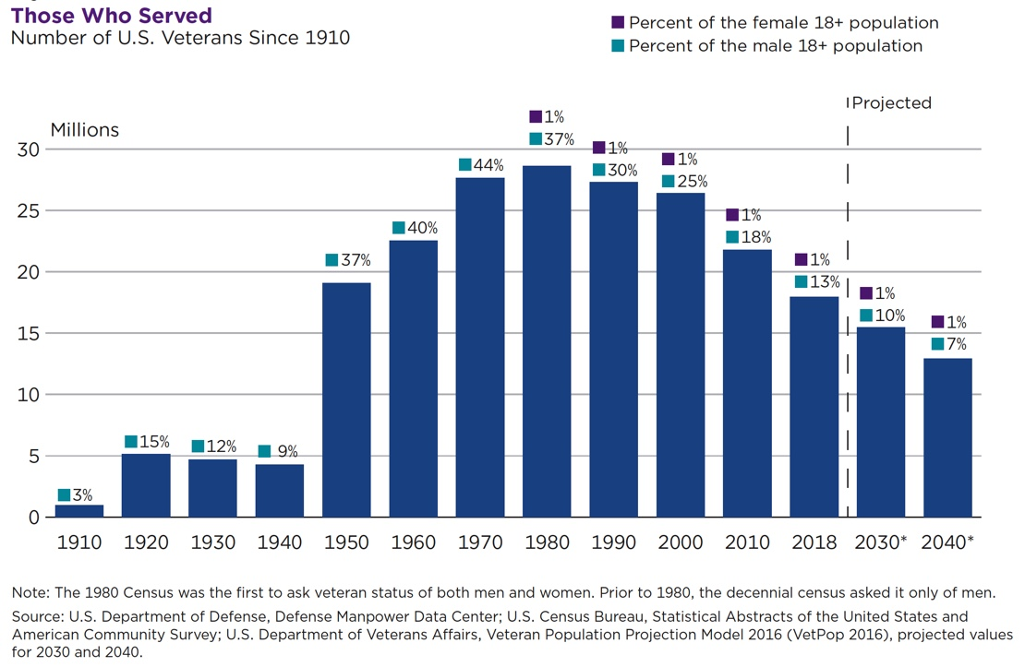
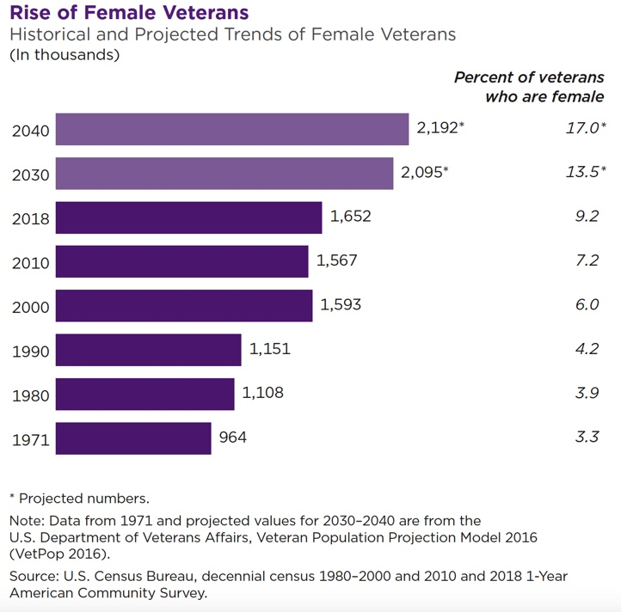
Veteran Definition & Demographics
VA: “a person who served in the active military, naval, or air service, and who was discharged or released therefrom under conditions other than dishonorable.”
COPYRIGHT
Notes:
The percentage of veterans in the US has not been this low since 1940 – since before WW II - and it will continue to drop.
Within the next 15 years, veterans will comprise a smaller % of the US population than at any time since before WW I.
Although the overall population of veterans continues to fall, the percentages of some demographics within that population is rising

Slide 39
The Civil-Military Divide
Civilians
Military
COPYRIGHT
Notes:
That lack of familiarization and understanding draws us further apart.

Slide 40
The Civil-Military Divide
Civilians
Military
COPYRIGHT
Notes:
That lack of familiarization and understanding draws us further apart.

Slide 41
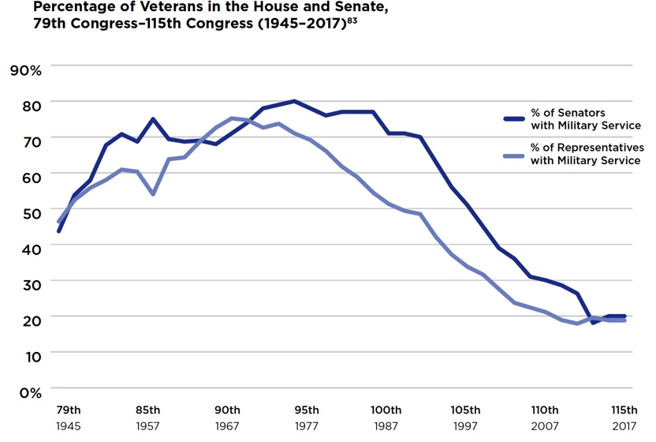
Elected veteran leadership is at an historic low
99.5% of the American public has not served on active duty at any given time in the period since 9/11.
Sources: Phillip Carter, Amy Schafer, Katherine Kidder and Moira Fagan, “Lost in Translation: The Civil-Military Divide and Veteran Employment,” Center For a New American Security, June 15, 2017, 3. Bruce Drake, “On Memorial Day, public pride in veterans, but at a distance,” Pew Research Center, May 24, 2013, accessed January 2, 2017, http://www.pewresearch.org/fact-tank/2013/05/24/on-memorial-day-public-pride-in-veterans-but-at-a-distance-2/. Gretchen Livingston, “Profile of U.S. veterans is changing dramatically as their ranks decline,” Pew Research Center, November 11, 2016, accessed January 2, 2017, http://www.pewresearch.org/fact-tank/2016/11/11/profile-of-u-s-veterans-is-changing-dramatically-as-their-ranks-decline/.
COPYRIGHT
Notes:
As the chart indicates, Elected veteran leadership is at an historic low
99.5% of the American public has not served on active duty at any given time in the period since 9/11.

Slide 42
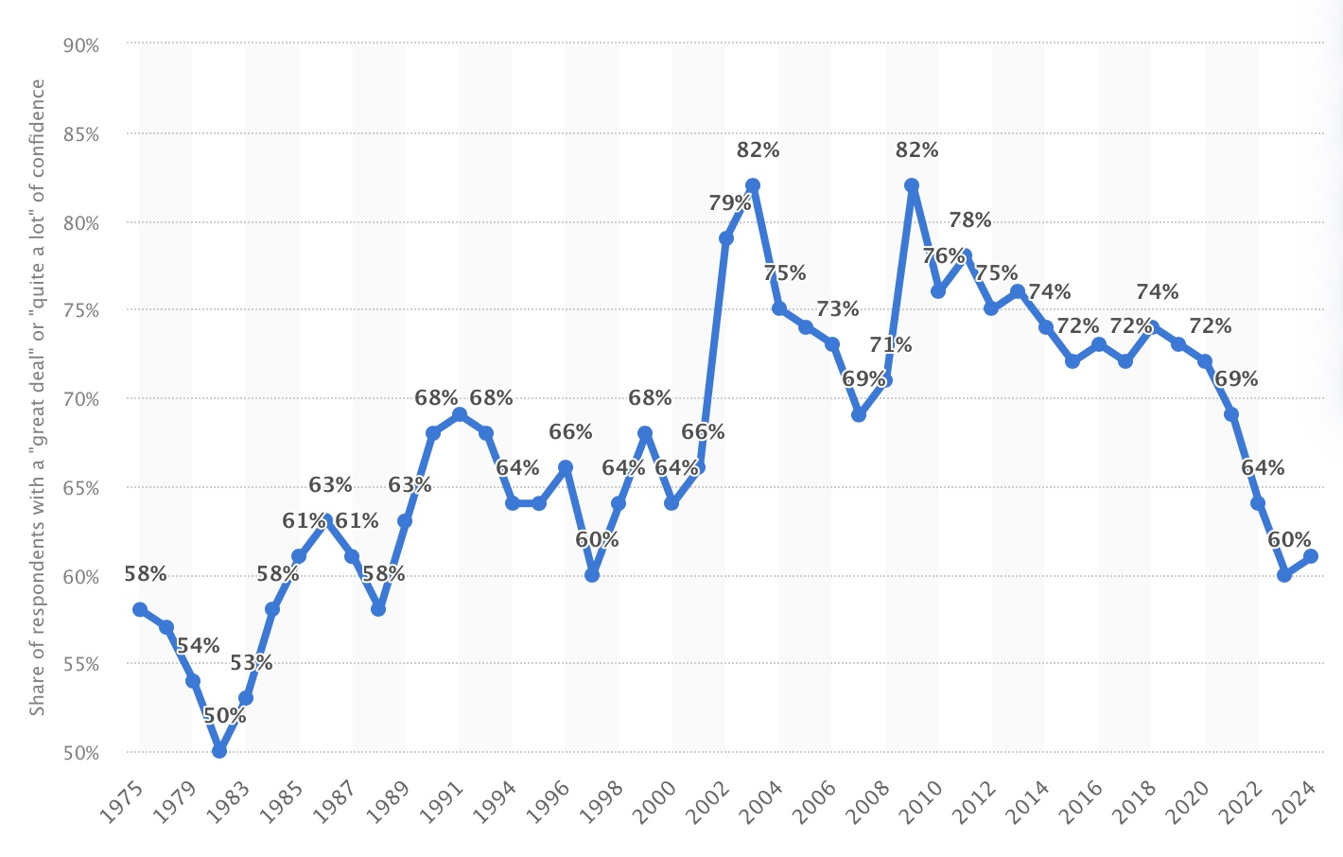
Public Confidence Levels in the US Armed Forces
Public confidence levels in the US armed forces haven’t been this low since before 9/11.
Sources: “Public confidence levels in the United States armed forces from 1975 to 2024,” Statista Research Department, October 1, 2024, accessed October 1, 2024, https://www.statista.com/statistics/239149/confidence-in-the-us-armed-forces/.
COPYRIGHT
Notes:
As the chart indicates, Elected veteran leadership is at an historic low
99.5% of the American public has not served on active duty at any given time in the period since 9/11.

Slide 43
The Civil-Military Divide
Civilians
Military
COPYRIGHT
Notes:
That lack of familiarization and understanding draws us further apart.

Slide 44
The Civil-Military Divide
Civilians
Military
COPYRIGHT
Notes:
That lack of familiarization and understanding draws us further apart.

Slide 45
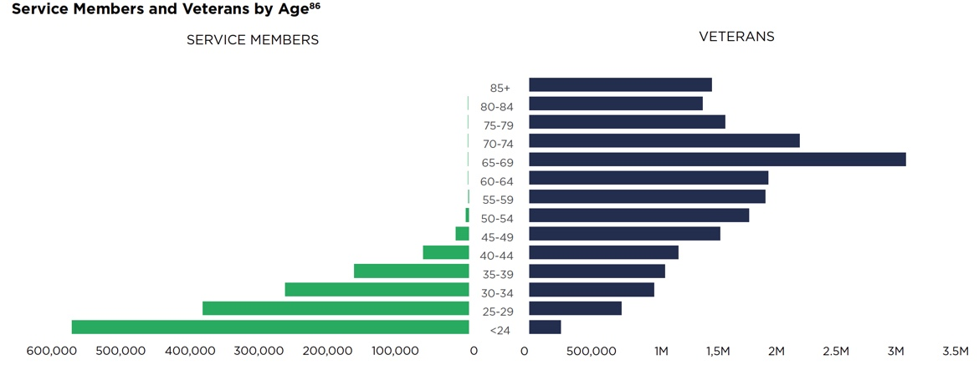
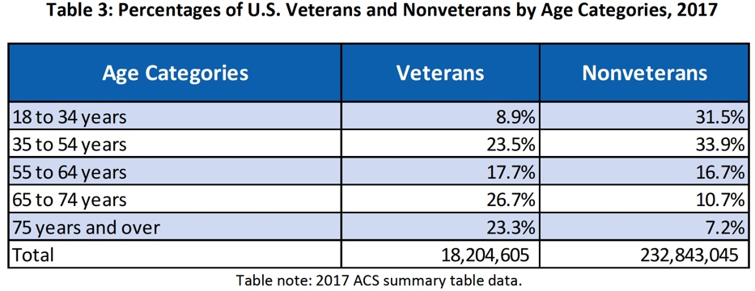
Large numbers of veterans enter a workforce whose leaders no longer include them
Traditional retirement age
Half of veterans are beyond retirement age
2009 study: 90% drop between 1980 and 2006 in the number of large publicly-held corporations whose CEOs had a military background
WSJ reports this percentage to now be 2.6%!
Even if you include all S&P 500 board members, that percentage is still less than 5%
Sources: (Above) Phillip Carter, Amy Schafer, Katherine Kidder and Moira Fagan, “Lost in Translation: The Civil-Military Divide and Veteran Employment,” Center For a New American Security, June 15, 2017, 5. (Right) Texas Workforce Investment Council, “Veterans in Texas: A Demographic Study,” June 2019, 6. Benmelech, Efraim & Frydman, Carola. "Military CEOs," Journal of Financial Economics, vol. 117, no. 1 (2015): 43-59, accessed on July 2, 2017, http://www.nber.org/papers/w19782.pdf. Vanessa Fuhrmans, “Generals Bring Battlefield Expertise to the Business World: Employers are tapping military leaders to develop leadership talent, provide corporate governance and oversee cybersecurity strategy,” Wall Street Journal, August 29, 2017, accessed August 31, 2017, https://www.wsj.com/articles/generals-bring-battlefield-expertise-to-the-business-world-1504008002?shareToken=st0173955a9a9e4f4d9d7c2056ac1f3e19&reflink=article_email_share&mg=prod/accounts-wsj.
COPYRIGHT
Notes:
Even more impactful, leaders in today’s corporate world tend to not include veterans.
Start with the fact that half of veterans are beyond retirement age [CLICK]
Add to that the fact that only 2.6% of publicly-held corporations had CEOs with ANY military background – which is a 90% drop since 1980.
So what?
There are fewer and fewer corporate leaders that understand who veterans are, what they’ve done, and what they can do.

Slide 46
Today’s veterans have the opposite problem of Vietnam-era veterans
Veteran Era | Vietnam | Post-9/11
Acceptance by Society | Cold | Very Warm
Benefits | Fewer | Many
Employment Outcomes | Good | Poor
Senior Management with Military Background | 59% | 2.6%
Suicide rates | 11.6 per 100k (1980) | 34.7 per 100k (2022)
Tripled Suicide Rates
Sources: “2024 National Veteran Suicide Prevention ANNUAL REPORT, Part 2 of 2: Report Findings,” Office of Suicide Prevention, US Department of Veterans Affairs, December 2024, page 8, accessed March 23, 2025: https://www.mentalhealth.va.gov/docs/data-sheets/2024/2024-Annual-Report-Part-2-of-2_508.pdf. William E Datel, Ph.D. and COL Franklin D. .Jones MC, USA, “Suicide In United States Army Personnel, 1979-1980,” MILITARY MEDICINE, October 1982, page 843, accessed March 23, 2025, https://apps.dtic.mil/sti/tr/pdf/ADA121565.pdf.
COPYRIGHT
Notes:
Even more impactful, leaders in today’s corporate world tend to not include veterans.
Start with the fact that half of veterans are beyond retirement age [CLICK]
Add to that the fact that only 2.6% of publicly-held corporations had CEOs with ANY military background – which is a 90% drop since 1980.
So what?
There are fewer and fewer corporate leaders that understand who veterans are, what they’ve done, and what they can do.

Slide 47
The Civil-Military Divide
Civilians
Military
COPYRIGHT
Notes:
That lack of familiarization and understanding draws us further apart.

Slide 48
The Civil-Military Divide
Civilians
Military
COPYRIGHT
Notes:
That lack of familiarization and understanding draws us further apart.

Slide 49
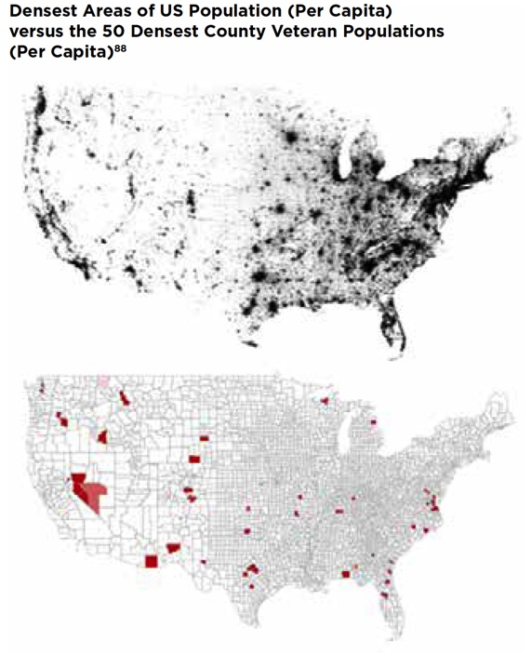
The American public does not live near or interact with the military population
84% of post-9/11 veterans say the public does not understand the problems those in the military face
76% of pre-9/11 veterans and 71% of the public agree
Sources: Phillip Carter, Amy Schafer, Katherine Kidder and Moira Fagan, “Lost in Translation: The Civil-Military Divide and Veteran Employment,” Center For a New American Security, June 15, 2017, 5. Bruce Drake, “On Memorial Day, public pride in veterans, but at a distance,” Pew Research Center, May 24, 2013, accessed January 2, 2017, http://www.pewresearch.org/fact-tank/2013/05/24/on-memorial-day-public-pride-in-veterans-but-at-a-distance-2/.
COPYRIGHT
Notes:
Even more directly, The American public does not live near or interact with the military population. Check out the heat maps on the right side of the slide
84% of post-9/11 veterans say the public does not understand the problems those in the military face
76% of pre-9/11 veterans and 71% of the public agree

Slide 50
The Civil-Military Divide
Civilians
Military
COPYRIGHT
Notes:
That lack of familiarization and understanding draws us further apart.

Slide 51
The Civil-Military Divide
Civilians
Military
COPYRIGHT
Notes:
That lack of familiarization and understanding draws us further apart.

Slide 52
A new veteran population is growing, but without a safety net…
~200,000 veterans matriculate into the civilian work sector annually
~70% of them will transition short of retirement and without a pension
~51% of them agree that they are well-prepared to successfully navigate the transition to civilian life
COPYRIGHT
Notes:
Sources: U.S. Department of Veterans Affairs, VetPop 2007 Data, “Table 2S: Separations by State, Period, Age Group, Gender 2000-2036,” 2007. U.S. Department of Defense, “2015 Demographic Profile of the Military Community,” 2015, accessed December 31, 2016, http://download.militaryonesource.mil/12038/MOS/Reports/2015-Demographics-Report.pdf. Maury, R., Stone, B., Bradbard, D.A., Armstrong, N.A., Haynie, J.M., “Workforce Readiness Alignment: The Relationship Between Job Preferences, Retention, and Earnings (Workforce Readiness Briefs, Paper No. 3),” Institute for Veterans and Military Families, Syracuse University, August 2016, accessed October 27, 2017, https://ivmf.syracuse.edu/wp-content/uploads/2016/08/USAA_paper3_8.30.16_REVISED_digtial.pdf.

Slide 53
…while most organizations are not structured to capitalize on the opportunity
90% of non-veteran owned small businesses, who make up > 99% of the businesses in the country and responsible for 42% of new jobs, do NOT intentionally hire veterans
According to a Korn Ferry survey of 700 businesses:
  80% of organizations do NOT have veteran-specific hiring programs
  71% of organizations do NOT provide talent acquisition professionals training on hiring veterans
  52% of organizations do NOT provide onboarding or transition support to veteran hires
COPYRIGHT
Notes:
Sources: Roy Maurer, “8 in 10 Employers Lack Recruitment Programs for Veterans,” Medium.com, May 25, 2015, accessed August 26, 2022, https://medium.com/@HRCaroline/8-in-10-employers-lack-recruitment-programs-for-veterans-3426e6ba72ae. “Small Business Index: The Voice of Small Business Owners,” Metlife & US Chamber of Commerce, Q3 2019, accessed August 26, 2022, https://www.uschamber.com/sbindex/uploads/SBI_2021_Q1.pdf.

Slide 54
So What?
More veterans are entering a nation…
  Whose elected leaders don’t represent them
  Whose corporate leaders don’t include them
  Whose population doesn’t look like them or live near them
  Whose employers don’t understand them
  …and for which they are unprepared
Employers, while incentivized to hire veterans…
  Typically don’t have effective programs to identify, hire, train, and retain vets
  Face the challenge of justifying doing so for an ever-shrinking minority of their work force…and in the face of constantly shrinking budgets
COPYRIGHT
Notes:
More veterans are entering a nation…
Whose elected leaders don’t represent them
Whose corporate leaders don’t include them
Whose population doesn’t look like them or live near them
Whose employers don’t understand them
…and for which they are unprepared
Employers, while incentivized to hire veterans…
Typically don’t have effective programs to identify, hire, train, and retain vets
Face the challenge of justifying doing so for an ever-shrinking minority of their work force…and in the face of constantly shrinking budgets
This gap drives many transition challenges, as it causes a lack of knowledge, familiarity, and interaction

Slide 55
Hiring Veterans
How You Can Help

Slide 56
Three Points
Get educated
Help educate others
Engage with the community of professionals trying to make a difference
COPYRIGHT

Slide 57
Hiring Veterans
Resources

Slide 58
Resources for Supporting Veteran Mental Health
📘 Books
Mission Transition – Step-by-step guide for veterans navigating career shifts. Emphasizes employment as a pillar of post-military wellness.
Hiring Veterans – Evidence-based best practices for employers to attract, integrate, and retain veteran talent.
📊 Research & Data
Veterans Metrics Initiative (TVMI): Longitudinal study linking employment with transition success and wellness. (veteranetwork.psu.edu/projects/tvmi-study/). POC: Dr. Daniel Perkins, Principal Scientist (Founder)
IVMF – Syracuse University: Leading research hub for veteran employment and community integration. (ivmf.syracuse.edu). POC: Dr. J. Michael Haynie, Vice Chancellor for Strategic Initiatives & Innovation
RAND – Veteran Employment Reports: Employer insights, hiring outcomes, and retention strategies. (rand.org/topics/veterans-employment). POC: Dr. Carrie Farmer, Family Veterans Policy Research Institute
🏛 Government & National Programs
Dr. Nathan Ainspan: Senior Research Psychologist, Military-Civilian Transition Office, US Department of Defense
  Hosts a monthly research forum. Email him to join for free: nathan.d.ainspan.civ@mail.mil
Department of Labor VETS: Employment and training resources for veterans and employers. (dol.gov/agencies/vets)
  Transition Assistance Program (TAP) / Off-Base Transition Training
  National Veterans’ Training Institute
  Employment Navigator & Partnership Program
  HIRE Vets Medallion Program
Hiring Our Heroes: National employer-veteran connector w/ fellowship programs and hiring fairs. (hiringourheroes.org)
AmericaServes: Coordinated care networks connecting veterans to employment, mental health, housing, and more. (americaserves.org). More generically, Veteran Collaboratives (matthewjlouis.com/veteran-collaboratives/).
COPYRIGHT

Slide 59
Resources for Supporting Veteran Mental Health
🧠 Employment + Mental Health
Cohen Veterans Network Military Family Clinics: National nonprofit research on the link between meaningful employment and post-service mental wellness. (cohenveteransnetwork.org)
VA Solid Start Program (and other VA transition programs): Outreach program engaging veterans in their first year post-transition. (benefits.va.gov/transition/solid-start.asp)
💻 Tools & Platforms
Purepost: AI-powered platform matching veteran skills to career pathways. (purepost.co)
LinkedIn for Veterans: Free premium access, career tools, and veteran community support. (linkedin.com/military)
🎓 Training Resource Spotlight: PsychArmor (psycharmor.org)
Free, on-demand training for employers, clinicians, and community members to better understand and support veterans.
Top Courses:
15 Things Veterans Want You to Know
Creating a Veteran-Inclusive Workplace
Treating PTSD in Veterans
Hiring and Retaining Veterans with Invisible Wounds
✅ Employer Best Practices
Veteran Jobs Mission
(veteranjobsmission.com)
Large Companies |  | Small Companies | Academia | Government
JPMorgan Chase Prudential Amazon P&G | Wal-Mart Tesla USAA ADP Schlumberger | Cajun Industries Performance Contractors | Xavier University Butler University | State Department
COPYRIGHT

Slide 60
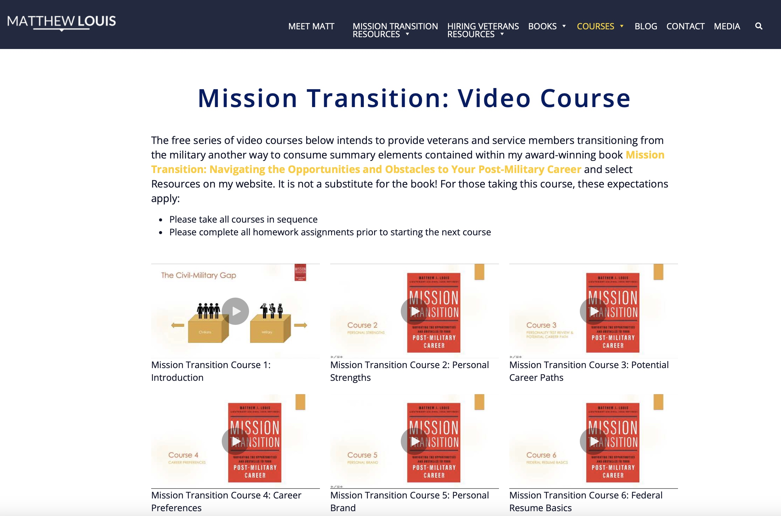
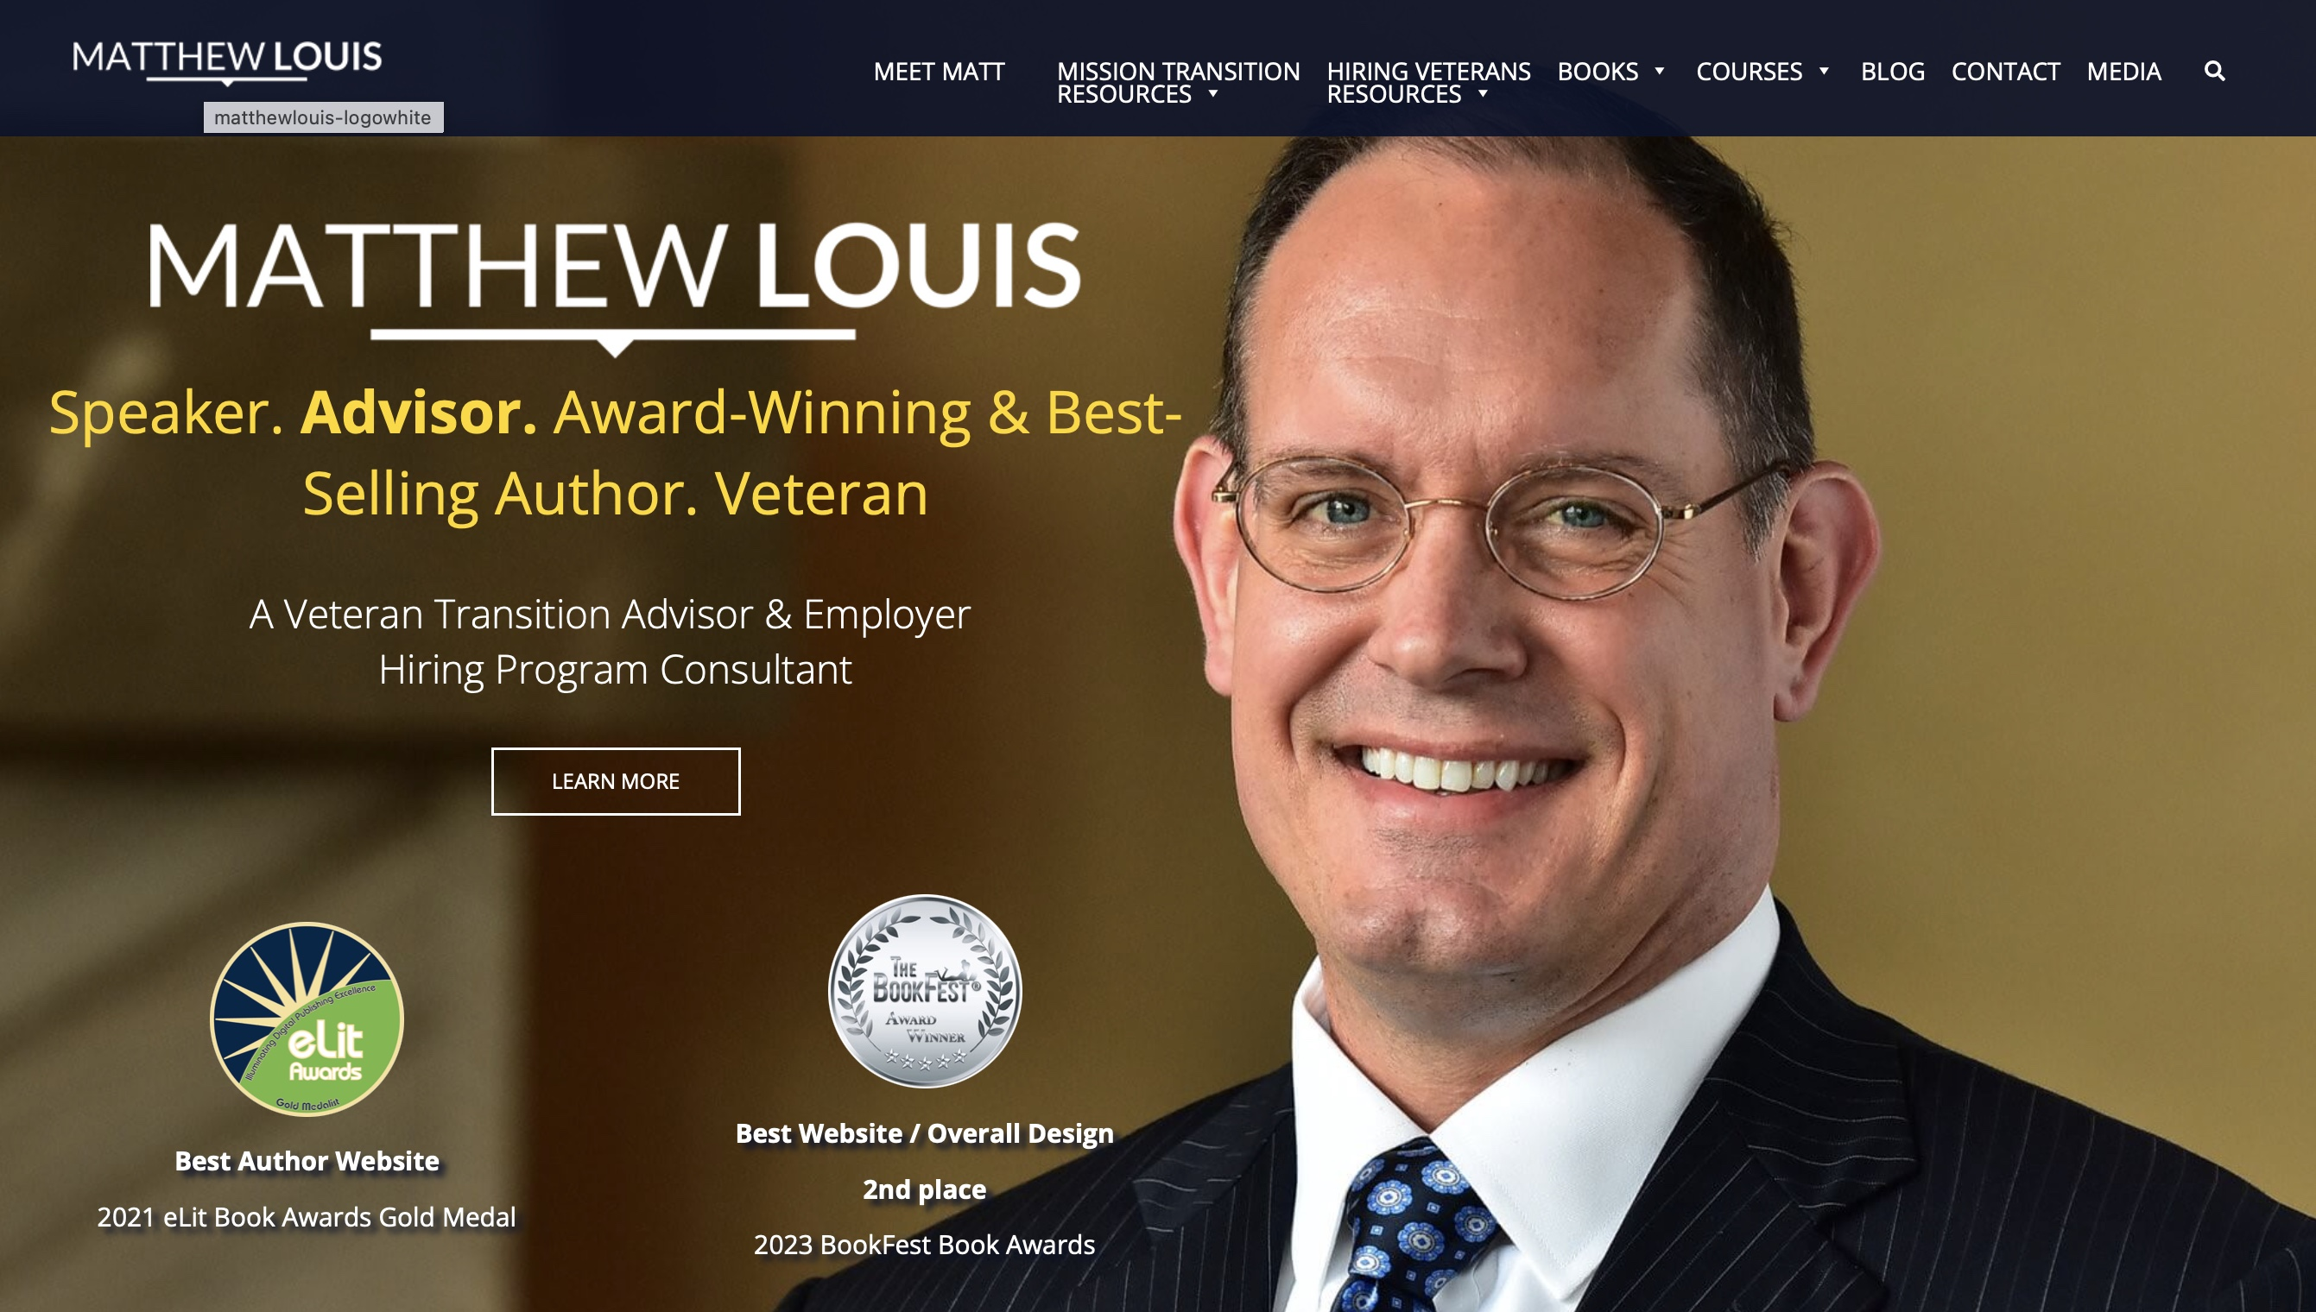
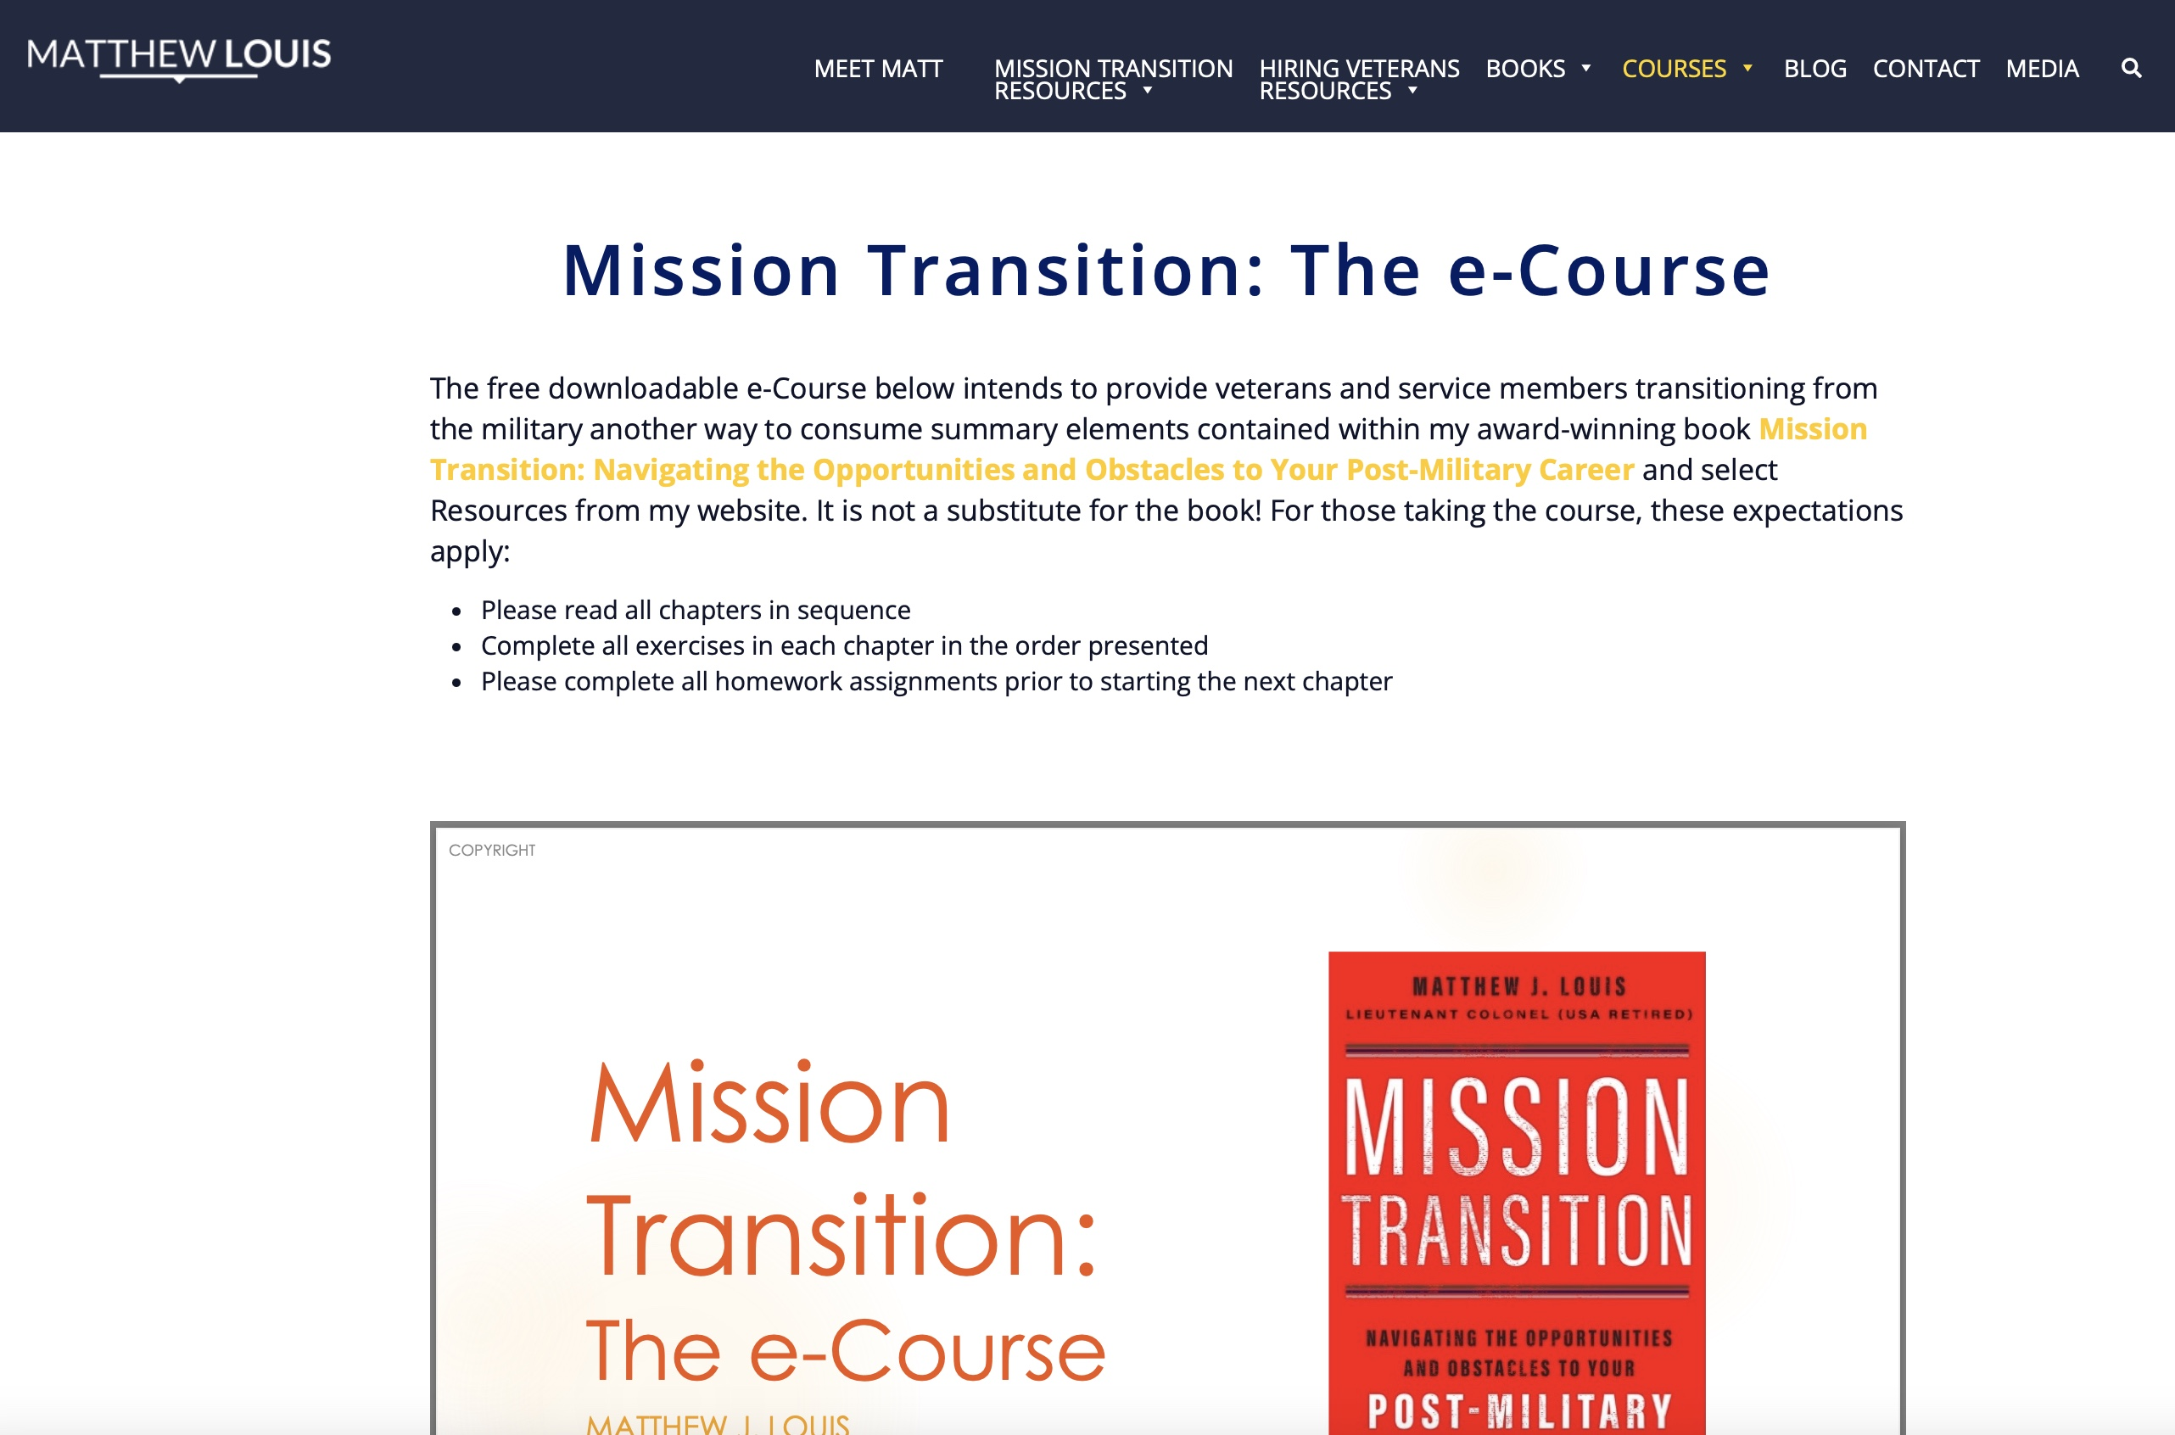
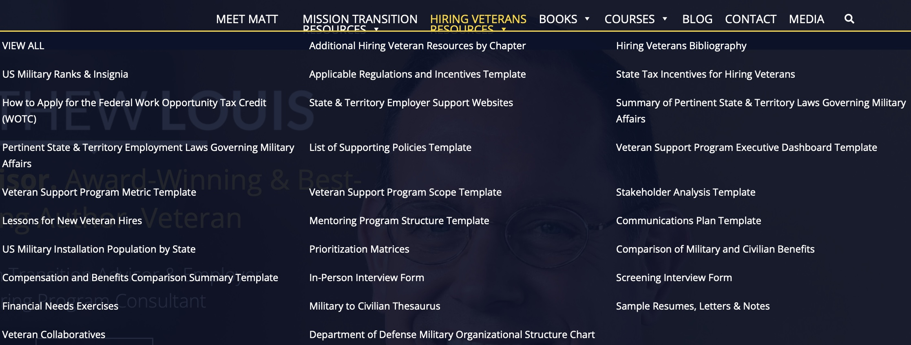


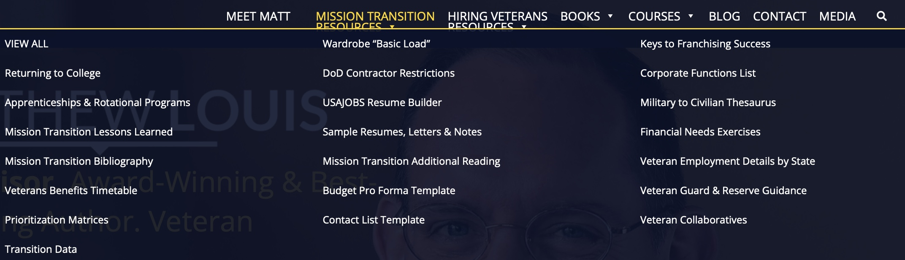
My Website www.matthewjlouis.com
Free Courses
Free Resources
21 free video courses; free e-course
Tons of free resources
  Thorough Military-to-Civilian thesaurus
  Resume / Letter templates
  Financial needs exercises
  Repository for lessons learned
  Additional Reading & Guidance (RC/Guard)
  Interactive tools
COPYRIGHT
Notes:
I mentioned my website several times. Please check it out at MatthewJLouis.com
I have a bunch of valuable free resources for you.

Slide 61






Purepost Services & Who We Serve
Create Passport, Upskill, Get Hired
Build Profile in 10 mins
Acquire Talent
Find Talent in 10 mins
Supply Meets Demand
Who Benefits:
FREE
Who Benefits:
U.S. Military Veterans
Any Job Seeker
Small & Medium Sized Businesses
Enterprises
Manpower Organizations
Who Benefits:
Case Manage Job Seekers
Enable Job Matches in 10 mins
Veteran Service Orgs
Technical Schools
College and University Career Centers
Talent Networks (ERGs)
State Workforce Agencies
Optimally Deploy Internal Talent
Who Benefits:
Any organization
COPYRIGHT

Slide 62
Hiring Veterans
Best Practices

Slide 63
Minimum Requirements for Success
Top-down executive-level leadership and substantive material (financial and programmatic) support
Initiation of a veteran BRG
Onboarding and mentoring programs
Direct relationship between the Veteran Support Program’s outcome-based measures and the Employer’s Strategic Goals
Compliance with all regulatory obligations (i.e., USERRA, VEVRAA, ADA, FMLA, etc.)
  Where applicable, compliance with the Office of Federal Contract Compliance Program (OFCCP)
Sample Veteran Support Program Reporting Dashboard
COPYRIGHT

Slide 64
Potential Scope of a Veteran Support Program
(i.e., What Does Being Military- or Veteran-Friendly Mean?)
Training & Cultural
Awareness
Education
& Preferences
Internal Policies / Functions
Personnel
Value Chain
Corporate Philanthropy
Employee Assistance
Affinity Group / Mentors
Employment Lifecycle
Family Members
Veterans
Spouses
Enlisted
Officers
Guard & Reserve
Civilians
Suppliers
Sales policies (i.e., veteran discounts)
Community Members
Veteran Service Organizations
Chambers of Commerce
Internal to the Organization
External to the Organization
COPYRIGHT

Slide 65

“Table Stakes” Supporting Practices
Identifying
  A military-themed BRG
  Sources of military talent
Recruiting
  Dedicated recruiters
  Training materials
Interviewing / Hiring
  Trained interviewers
  Scripted question sets
Onboarding / Training
  Veterans self-identify
  Mentors and affinity groups
Deploying / Developing
  Strategic goal alignment
  Goals, feedback, and career paths
Retaining / Separating
  Reserve Component support
  Military spouses and portable careers
Employment Lifecycle
Re-Deploy
Recruit
Interview
Hire
Onboard / Train
Deploy / Develop
Retain / Separate
Identify
Re-Train
COPYRIGHT

Slide 66
Comparing Values, Behavior, and Culture
Values form the basis for behavior
Culture is the collective behavior of organizations
Values of Each Service
Army | Loyalty Duty Respect Selfless Service Honor Integrity Personal Courage
Marine Corps and Navy | Honor Courage Commitment
Air Force | Integrity First Service Before Self Excellence in All We Do
Space Force | Character Connection Commitment Courage
Coast Guard | Honor Respect Devotion to Duty
How do Military Values Compare?
Military Values | Your Organization’s Values
Honor and integrity Commitment, loyalty, and duty Courage Leadership by example Selfless service Respect Excellence Discipline
Source: Matthew J. Louis, Hiring Veterans: How to Leverage Military Talent for Organizational Growth (Newburyport, MA: Career Press, 2023).
COPYRIGHT

Slide 67


Interviewing & Interfacing with Veterans
Types of questions not to ask:
What kind of discharge did you get from the military?
When will you get deployed again?
Have you ever killed anyone?
Were you ever injured in combat?
Will you have to miss much work for your National Guard or Reserve military service?
Types of questions to ask:
What did you do in the military?
Which of your military experiences will translate to this job?
Will you be able to perform the duties in the job description with reasonable accommodation?
COPYRIGHT
Source: Matthew J. Louis, Hiring Veterans: How to Leverage Military Talent for Organizational Growth (Newburyport, MA: Career Press, 2023).
COPYRIGHT

Slide 68
Networking Assimilation Process
Initiate discussions with peers and veteran support groups both inside and outside of the workplace
Mentors and affinity group members help connect veterans with other civilian employees that are likewise educated on your background
That educated base of employees then connects veterans with the balance of the organization
The sooner that veterans assimilate using this approach, the better
Balance of the Organization
Educated Base of Employees
Mentors & Affinity Group Members
Veteran New Hires
COPYRIGHT
Source: Matthew J. Louis, Hiring Veterans: How to Leverage Military Talent for Organizational Growth (Newburyport, MA: Career Press, 2023).
COPYRIGHT

Slide 69
Tailor Hiring & Onboarding Process by Veteran Hire Type
Veteran Population Type
Hire without industry experience | Hire with industry experience | Hire from under-graduate school | Hire from graduate school | Retiree hire
Informal supervisor check-in
Executive Champion meeting Paired w Mentor
Formal supervisor feedback | Affinity Group Activity Formal supervisor feedback
Mentor touch-point Veterans Assimilation Training | Affinity Group Activity Veterans Assimilation Training (optional)
Mentor touch-point Informal supervisor check-in | Informal supervisor check-in Affinity Group Activity
Mentor touch-point Affinity Group Activity | Affinity Group Activity
Formal supervisor feedback | Affinity Group Activity Formal supervisor feedback
Mentor touch-point Informal supervisor check-in | Affinity Group Activity
Mentor touch-point Affinity Group Activity | Affinity Group Activity
Mentor touch-point Affinity Group Activity | Affinity Group Activity
Formal supervisor feedback | Formal supervisor feedback Affinity Group Activity
Week 1
Welcome briefing
Month 1
Onboarding training
Personal goal identification
Informal supervisor check-in
Month 2
Executive Champion meeting
Paired w Mentor (optional)
Informal supervisor check-in
Month 3
Veteran Affinity Group Briefing
Mentor touch-point (optional)
Informal supervisor check-in
Month 4
Affinity Group Activity
Month 5
Affinity Group Activity
Veterans Assimilation Training
Month 6
Mentor touch-point (optional)
Month 7
Mentor touch-point (optional)
Month 8
Affinity Group Activity
Month 9
Informal supervisor check-in
Month 10
Mentor touch-point (optional)
Month 11
Mentor touch-point (optional)
Month 12
Affinity Group Activity
COPYRIGHT
Source: Matthew J. Louis, Hiring Veterans: How to Leverage Military Talent for Organizational Growth (Newburyport, MA: Career Press, 2023).
COPYRIGHT

Slide 70
Closing Thoughts
Questions

Slide 71
Our Agenda
Our nation faces an unprecedented security crisis
The civil-military divide is a major cause of that crisis
There is something everyone in this room can do to help resolve this crisis
COPYRIGHT

Slide 72

Thank You!
Matt@matthewjlouis.com
www.matthewjlouis.com
www.purepost.co
Matthew J. Louis
Louis Advisors, LLC
A Veteran-Owned Small Business
513-314-9870 (mobile)
COPYRIGHT
COPYRIGHT

Slide 73
Backup Slides

Slide 74
Hiring Veterans: The Assimilation Process
Understand veterans and military culture
Create support program content
Decision to support veteran hires
Identify & Recruit candidates
Interview & Decide on Hire
Finalize offer
Onboard, Deploy & Retain veteran hires
Validate Assimilation & Measure Success
Organize & staff veteran support program
Set expectations internally & externally
Time (measured in months)
Scope includes the entire employment lifecycle:
Re-Deploy
Recruit
Interview
Hire
Onboard / Train
Deploy / Develop
Retain / Separate
Identify
Re-Train
COPYRIGHT

Slide 75
Public Sector Supporting Practices
Leverage Special Hiring Authorities - Federal
  Veterans
    Veterans’ Recruitment Appointment (VRA)
    Veterans Employment Opportunity Act (VEOA)
    Schedule A Appointment Authority
    30% or More Disabled Veteran
    Disabled Veterans Enrolled in VA Training Program
    Executive Order 13518: Veteran Employment Initiative
  Military Spouses
    Executive Order 13832: Enhancing Noncompetitive Civil Service Appointments of Military Spouses
    Appointment of military spouses (5 US Code § 3330d)
Lean into your Veteran Employment Program Office (VEPO) – Federal
  Effectively organize – State Department example
Leverage Employer Support of the Guard and Reserve (ESGR) – All levels of government
  Employer awards
  Resolution of military commitment conflicts
COPYRIGHT

Slide 76
Public Sector Supporting Practices
Utilize additional sources of veteran talent
  Military scholars fellowships (all levels of government)
    Council on Foreign Relations (CFR) Military Fellowship
    White House Fellowship
    Veterans of Foreign Wars (VFW) – Student Veterans of America (SVA) Legislative Fellowship
    Anna Sobol Levy Foundation Fellowship
    Department of Homeland Security’s Secretary’s Honors Program
    The Smith Richardson Foundation Strategy and Policy Fellows Program
    Hertog War Studies Program
    Belfer Center Fellowships
  Disabled Veterans’ Outreach Program (DVOP) - all levels of government
  Local Veterans’ Employment Representatives (LVER) program - all levels of government
  Federal agency hiring programs
    Vets-to-Feds (V2F) Program
    Reintegration of Guard and Reserve Members
    Disabled Veterans Affirmative Action Program
    Women Veterans Hiring Initiative
COPYRIGHT

Slide 77
Public Sector Supporting Practices
Utilize additional sources of veteran talent (continued)
  Federally Sponsored Apprenticeship programs
    Department of Labor apprenticeships (all levels of government)
    Hiring Our Heroes Corporate Fellowship Program (all levels of government)
    Department of Defense Skillbridge Program (all levels of government)
    Army Career Skills Program (all levels of government)
    The State Department’s Veterans Innovation Partnership (VIP) Fellowship (Federal)
    The Department of Energy’s Veterans Programs (Federal)
    Office of the Secretary of Defense Fellows Program (Federal)
    United Services Military Apprenticeship Program (USMAP) - all levels of government
    The VA’s Veteran Readiness and Employment (VR&E) program (all levels of government)
  State Vocational Rehabilitation Agencies - State and Local
  Federal agency internships
    DoD’s Operation Warfighter
    Pathways
    VA Intern Programs
COPYRIGHT

Slide 78
Public Sector Supporting Practices
Employee Assistance Programs (EAP)
  Federal - mandatory
  State & Local
Veterans’ Preference in Reductions in Force (RIFs, Federal)
Lessons Learned & Continuous Improvement
  National Veteran Workforce Development Conference (NVWDC) – all levels of government
  Chief Human Capital Officers Council webpage (Federal)
  US Office of Personnel Management’s Reintegration Framework for Guard and Reserve members (all levels of government)
Awards
  DOL’s HIRE Vets Medallion Program
  ESGR Awards
  VETS Indexes
COPYRIGHT

Slide 79

Keys to Success
Support focused hiring efforts on veterans of all backgrounds, as well as their spouses. Support military spouse employment with child care options and flexible schedules.
Leverage the veterans you already have in-house in doing all of the above (i.e., internal referrals, mentoring, BRG leadership, training leads, etc.)
Utilize Purepost, the best way to match talent to your open requirements (www.purepost.co)
Encourage veterans to self-identify & read Mission Transition
Educate your employees @ veterans, especially managers and peers of veteran hires
Train recruiters and interviewers of veterans; have them read Hiring Veterans
Make the culture of your organization transparent to veteran candidates.
Leverage apprenticeship or rotational onboarding programs and Veteran Collaboratives
Team with ESGR and leverage their support of your Reserve Component employees
Identify relevant events (Veterans Day, Memorial Day, etc.) and celebrate success
Apply to all applicable military initiative recognition programs and for applicable tax incentives
Incorporate an experienced external advisor to enable your program’s success
COPYRIGHT

Slide 80


If You Have RC Members…
Watch this PsychArmor video:
15 Things Veterans Want You to Know
Thank military members for their service, but remember to thank their families. Kids and spouses make huge sacrifices to support their deployed family member.
Send deployed service members cards and care packages. They really enjoy getting them.
Acknowledge people who have been deployed. Say something to the service members themselves, like “It’s so good to see you home with us again. What are you up to this weekend?” or to their family, “I know your son was deployed last year, and I’m so happy he’s back home now,” or “I know your uncle died in combat, and I’m so very sorry for your loss.”
Be available to talk and listen about things in general, including the important aspects of returning to everyday life—job, hobbies, activities, etc. A simple, “How are you doing” or “How’s the job search going?” can be very comforting.
Engage in community activities. Some military members return to a huge network of friends and family; others do not. Arrange outings to baseball games, museums, or the movies.
Offer help in specific ways. Rather than saying “Let me know if I can help…” say, “I’d like to babysit for you this weekend—you deserve a night out.”
Help them feel like their service matters
Ensure them that, though the transition to the real world is difficult, there is a place for them
Offer a job if you or someone you know is hiring.
Encourage the use of:
  My book and my website
  Purepost Passports
  Veteran Collaboratives
  Internships or Apprenticeships
COPYRIGHT
COPYRIGHT

Slide 81
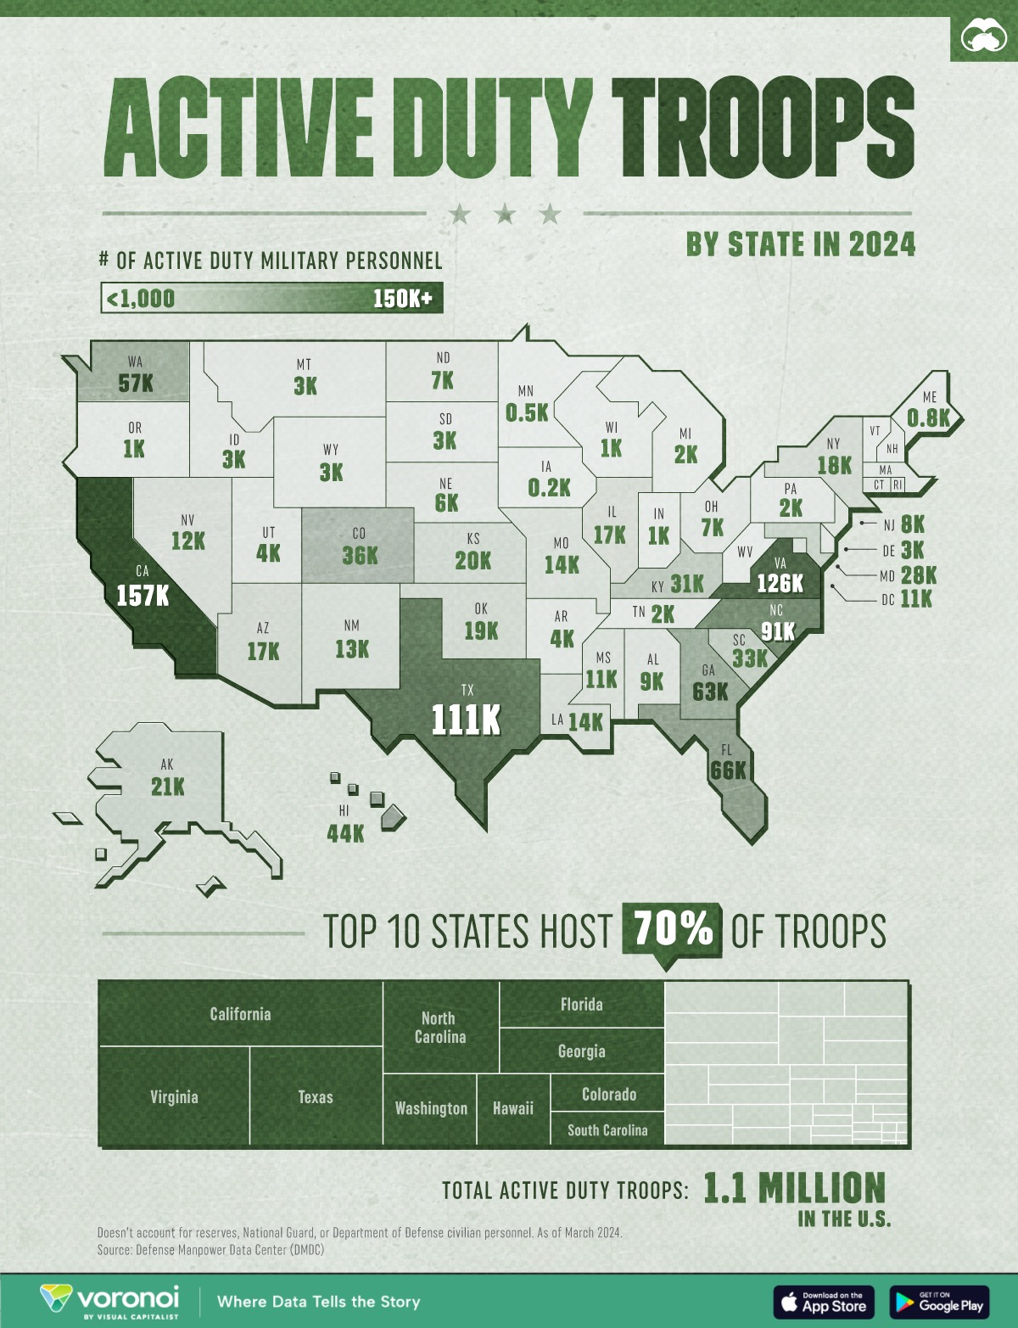
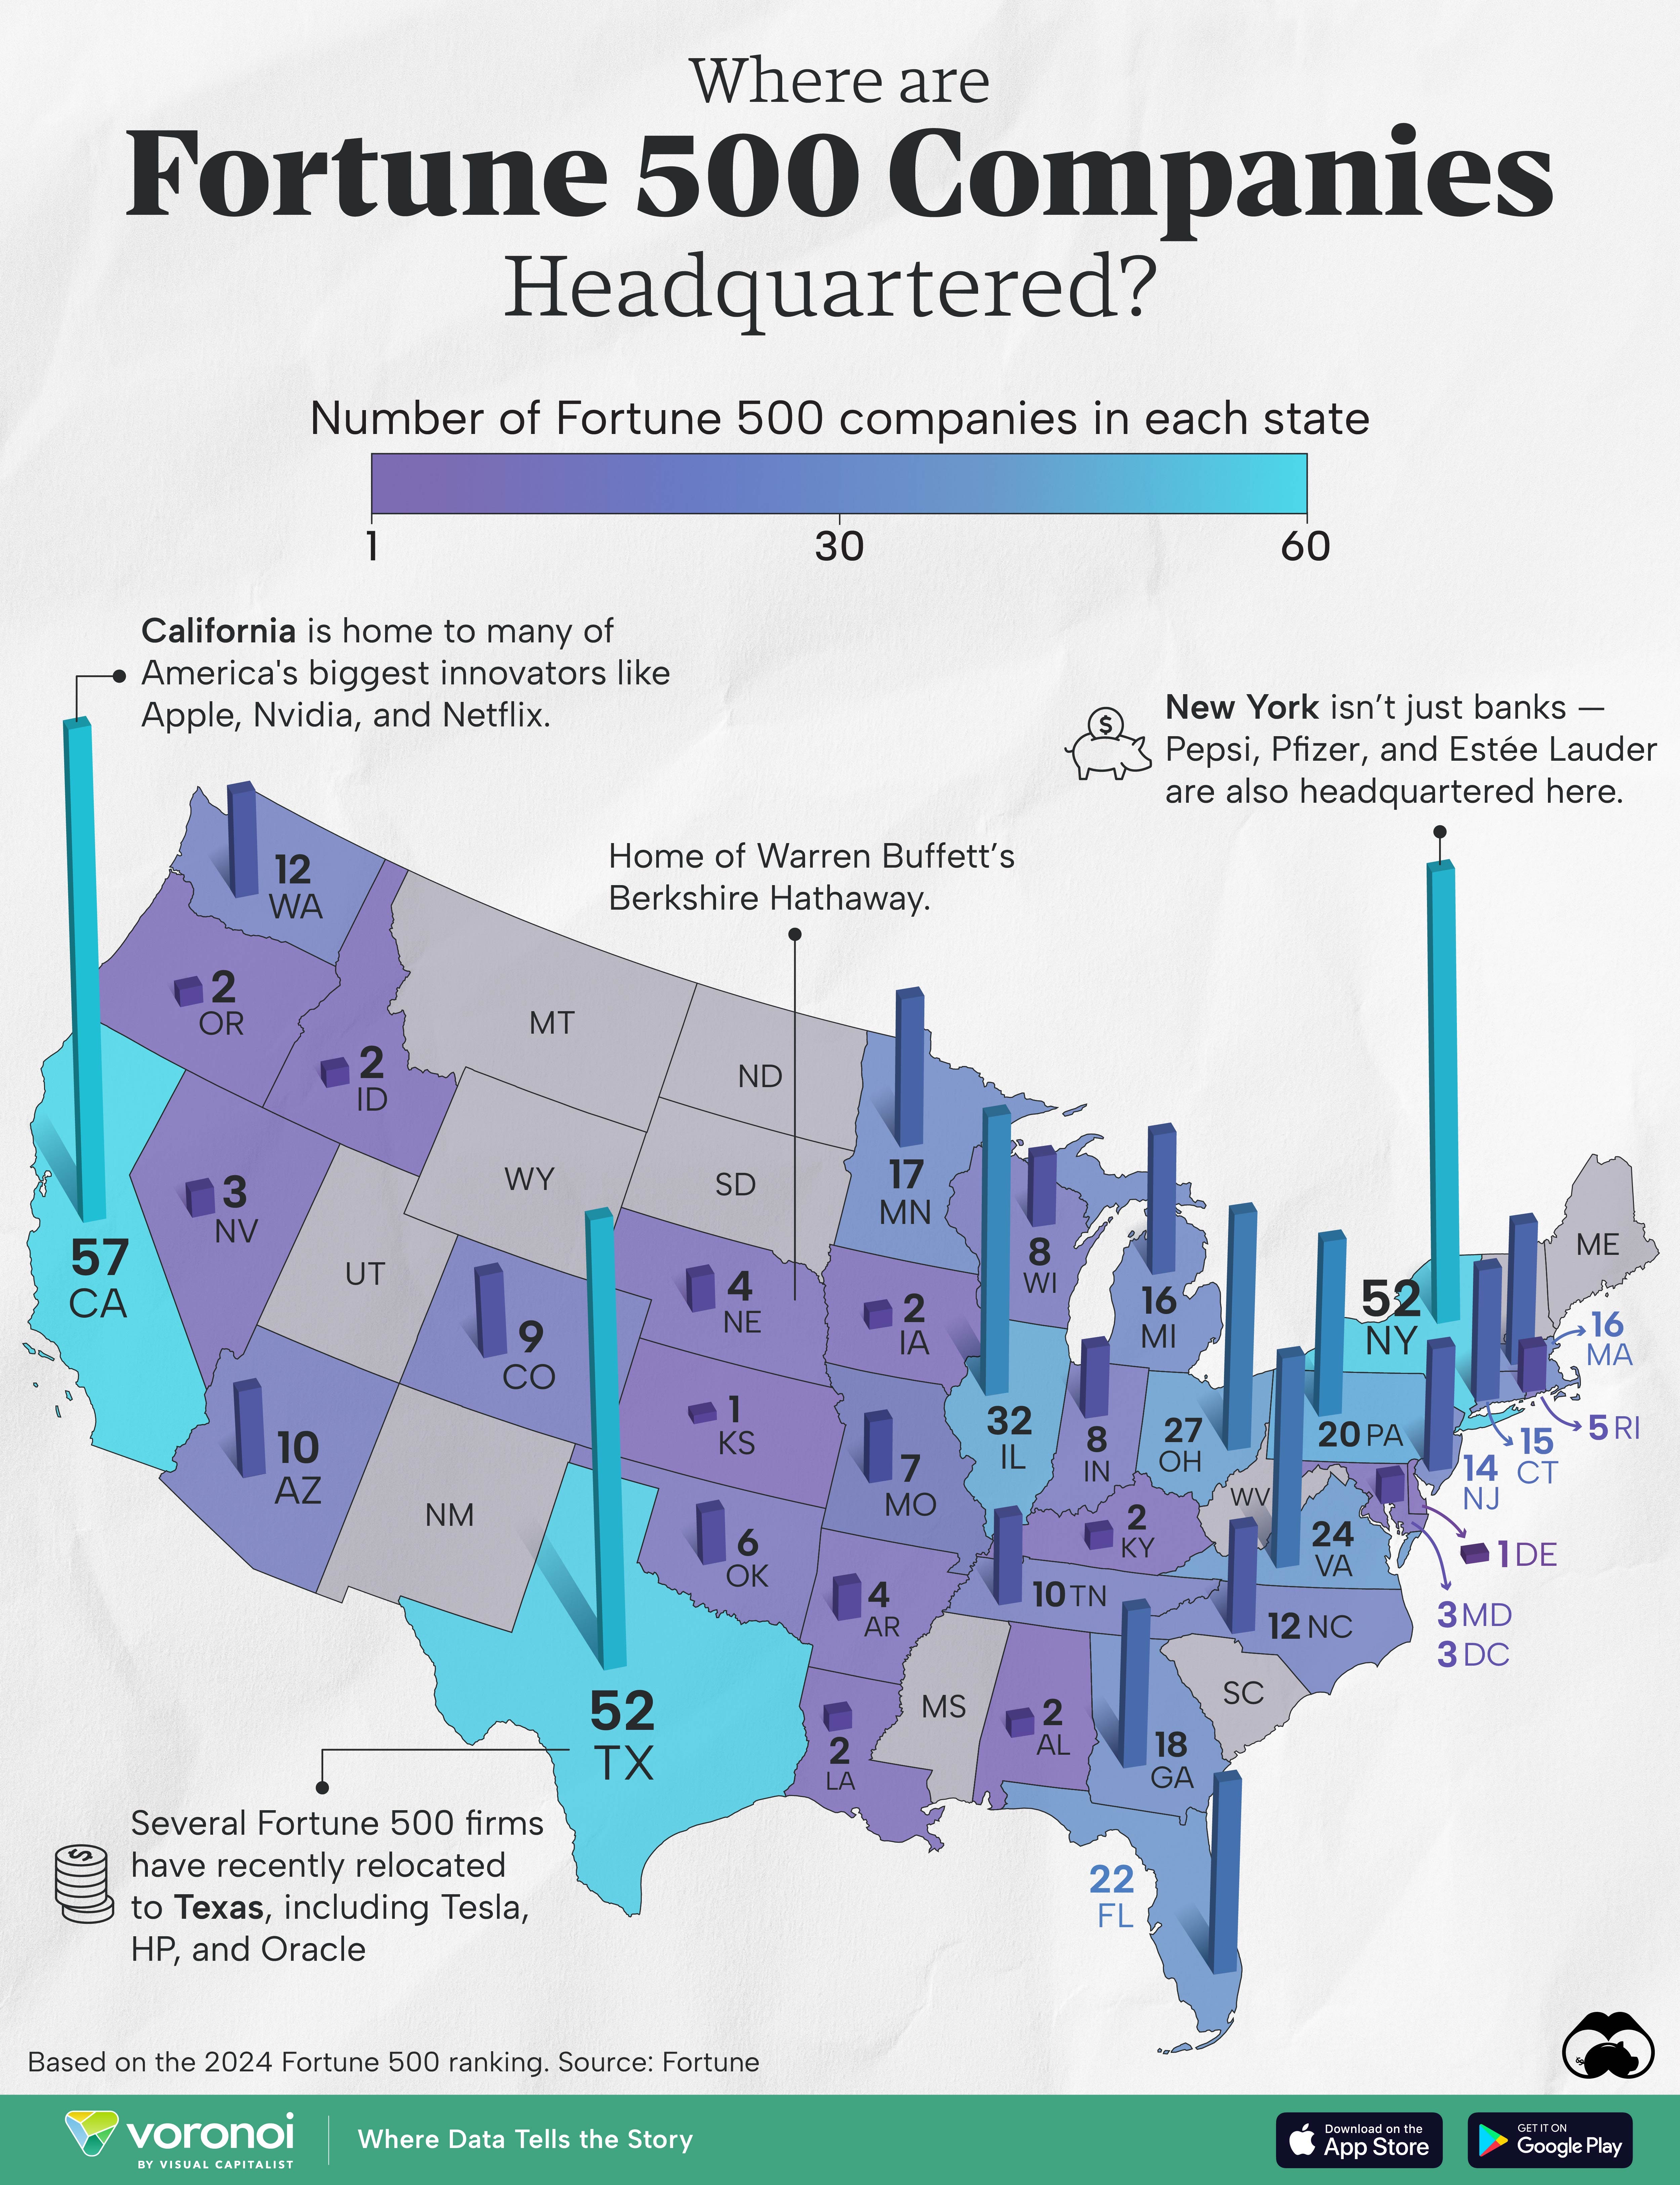

Slide 82
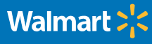










Case Studies
JPMorgan Chase
Prudential
Amazon
P&G
Wal-Mart
Tesla
USAA
ADP
Schlumberger
Cajun Industries
Performance Contractors
State Department
Xavier University
COPYRIGHT

Slide 83
Don’t…
Ask for specific details about combat
Ask a military member if he/she has shot or killed someone
Discuss politics or other current events involving combat
Confuse branches of the military
  Army = Soldiers
  Navy = Sailors
  Marines = Marine
  Air Force = Airmen/women
  Space Force = Guardians
  When in doubt, use the terms “service member,” “military,” or “veteran,” which apply to all branches
COPYRIGHT
COPYRIGHT

